Slide 1
ANGLEŠČINA ZA OTROKE
2. termin
My very first english

Slide 2



LEGENDA SIMBOLOV
KNOCK
potrkati

Slide 3


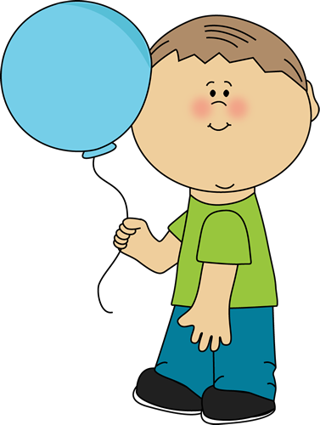


ADVENTURE
pustolovščina
GIRL
deklica
SOPHIE
JOHNNY
BOY
deček
FRIEND
prijatelj

Slide 4
HELLO FRIENDS! WE ARE BACK.
AND WE ARE READY FOR NEW ADVENTURES.

Slide 5





NUMBERS
1
2
3
WHAT‘S YOUR NAME?
COLOURS
5
4
6
ANIMALS
SEASONS
8
7
9

Slide 6
LET‘S REVISE
PONOVIMO

Slide 7
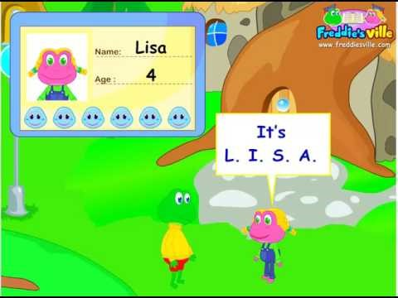
WHAT IS YOUR NAME ?

Slide 8
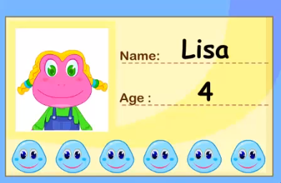
WHAT IS YOUR NAME ?
MY NAME IS LISA.
I AM 4 YEARS OLD.
Stara sem 4 leta.
Ime mi je Lisa.

Slide 9
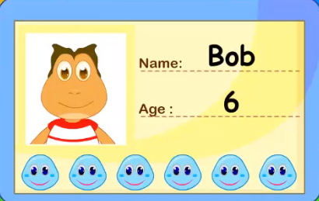
WHAT IS YOUR NAME ?
MY NAME IS BOB.
I AM 6 YEARS OLD.
Star sem 6 let.
Ime mi je Bob.

Slide 10
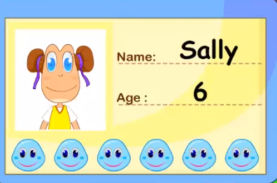
WHAT IS YOUR NAME ?
MY NAME IS SALLY.
I AM 6 YEARS OLD.
Stara sem 6 let.
Ime mi je Sally.

Slide 11
COLOURS
COLOUR PENCIL
barvica
ORANGE
WHITE
PURPLE
PINK
GREEN
GREY
BLUE
YELLOW
BROWN
RED
BLACK

Slide 12
COLOURS
ORANGE

Slide 13
COLOURS
ORANGE
GREEN

Slide 14
COLOURS
ORANGE
GREEN
BLUE

Slide 15
COLOURS
ORANGE
BLUE
GREY

Slide 16
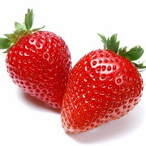
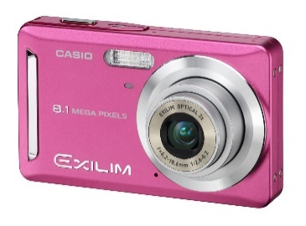


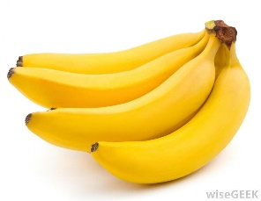

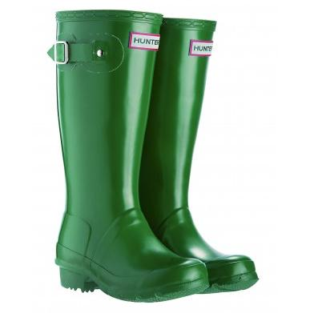





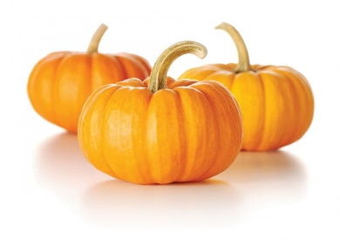




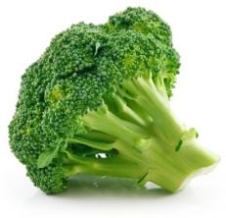


COLOURS AND NUMBERS
HOW MANY?
3
6
5
1
3
2
0

Slide 17


NUMBERS
HOUSE
hiša
1
2
3
4
5
6
7
8
9
10

Slide 18
NUMBERS
HOUSE
hiša
1
2
3
4
5
6
7
9
10

Slide 19
NUMBERS
HOUSE
hiša
1
2
3
5
7
8
9
10

Slide 20
NUMBERS
HOUSE
hiša
1
2
3
5
7
8
10

Slide 21


NUMBERS
HOUSE
hiša
1
2
3
4
5
6
7
8
9
10

Slide 22
NUMBERS
HOUSE
hiša
10
2
8
7
5
9
4
3
6
1

Slide 23





SEASONS

Slide 24
QUESTION: ARE ALL FRIENDS FROM THE SAME SEASON?

Slide 25
QUESTION: ARE ALL FRIENDS FROM THE SAME SEASON?
SUMMER
poletje
WINTER
zima
AUTUMN
jesen
SPRING
pomlad
ANSWER: NO.

Slide 26





QUESTION: WHO SAID WHAT?
In our season is COLD.
V našem letnem času je mrzlo.
In our season BIRDS START TO SING AGAIN.
V našem letem času spet začenjo peti ptice.
In our season is HOT.
V našem letnem času je vroče.
In our season PEOPLE CARVE PUMPKINS.
V našem letnem rezljamo buče.

Slide 27
QUESTION: WHO SAID WHAT?
In our season is COLD.
V našem letnem času je mrzlo.
In our season BIRDS START TO SING AGAIN.
V našem letnem času spet začenjajo peti ptice.
In our season is HOT.
V našem letnem času je vroče.
In our season PEOPLE CARVE PUMPKINS.
V našem letnem rezljamo buče.

Slide 28
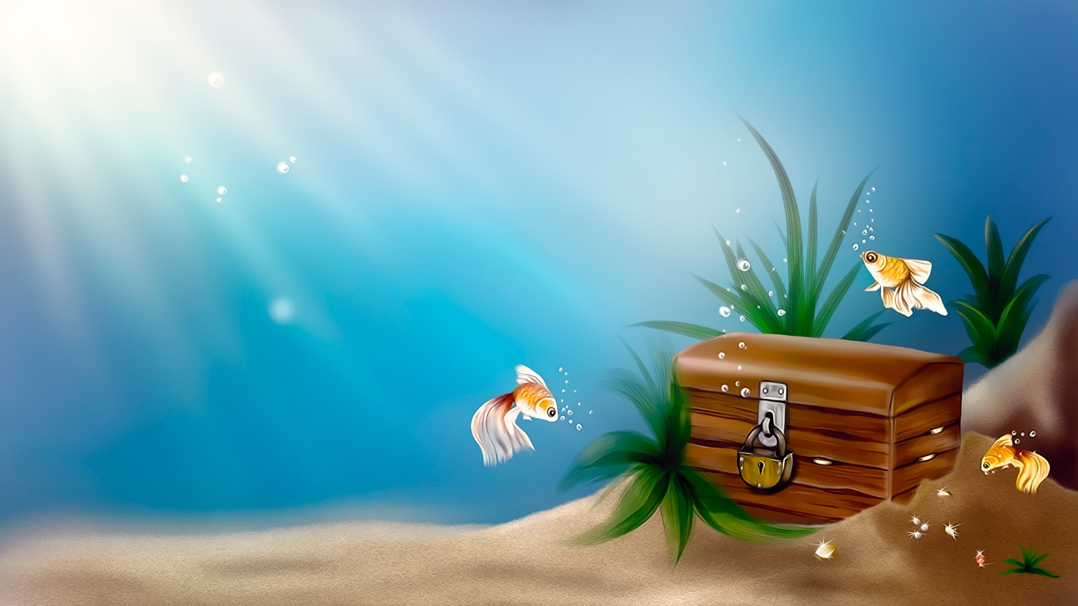
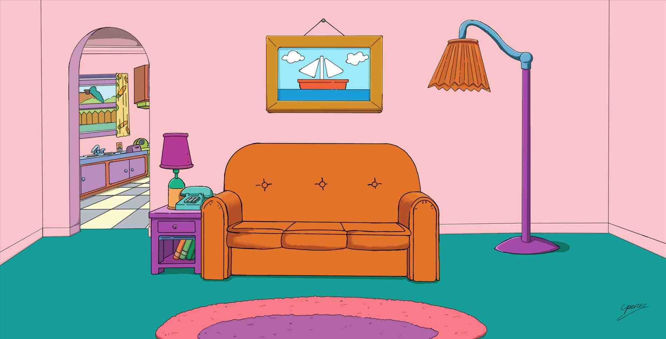

MIXED UP ANIMAL WORLDS
Zmešani živalski svetovi
WELCOME TO THE SEAWORLD
WELCOME TO OUR HOME
WELCOME TO THE ZOO
WELCOME TO THE FARM

Slide 29









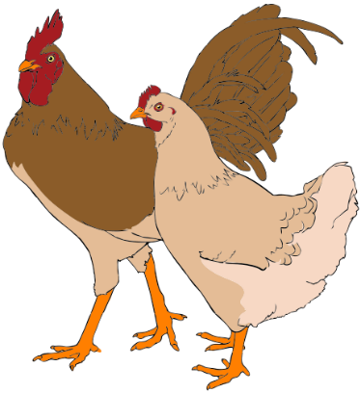


MIXED UP ANIMAL WORLDS
Zmešani živalski svetovi

Slide 30
MIXED UP ANIMAL WORLDS
Zmešani živalski svetovi

Slide 31

GOOD JOB!

Slide 32
?
ASK ME ANYTHING.
TIME FOR
QUESTIONS
Čas za vprašanja

Slide 33
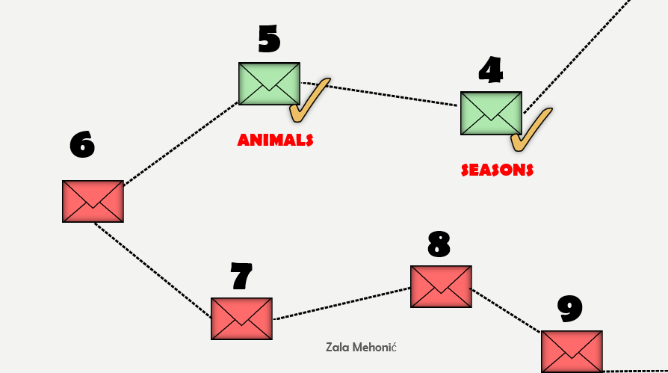

Slide 34

6
KNOCK
potrkati
KNOCK ON THE SCREEN

Slide 35
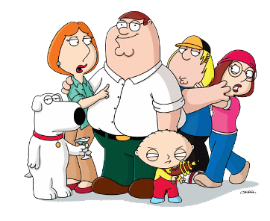
FAMILY
Družina

Slide 36
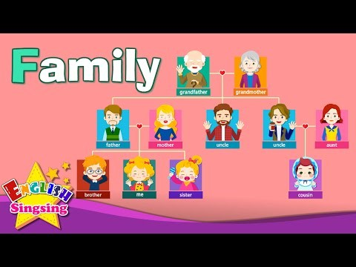
FAMILY MEMBERS
Družinski člani

Slide 37
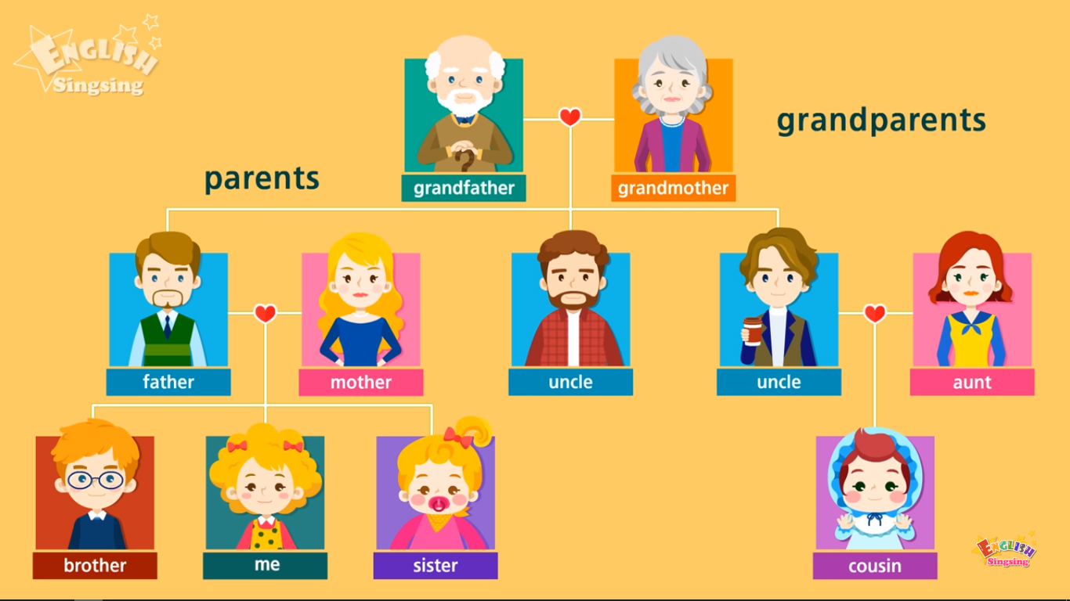
FAMILY MEMBERS
Družinski člani

Slide 38
FAMILY MEMBERS
SHOW IT WITH
YOUR FINGER
Družinski člani
Pokaži s prstom
https://www.youtube.com/watch?v=FHaObkHEkHQ
UNCLE
ME
COUSIN
GRANDMOTHER
MOTHER
GRANDFATHER
AUNT
SISTER
FATHER
UNCLE
BROTHER

Slide 39
AT SOPHIE‘S HOUSE
Pri Sophie doma
WELCOME TO MY HOME!

Slide 40
AT SOPHIE‘S HOUSE
Pri Sophie doma
I LIVE WITH PARENTS, ONE BROTHER AND ONE SISTER.

Slide 41
AT SOPHIE‘S HOUSE
Pri Sophie doma
I WOULD REALLY LIKE TO INTRODUCE THEM TO YOU.

Slide 42
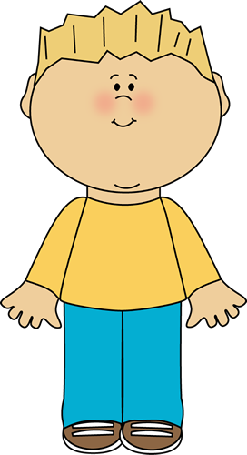

AT SOPHIE‘S HOUSE
Pri Sophie doma
TOM
SARA
BROTHER
brat
SISTER
sestra

Slide 43
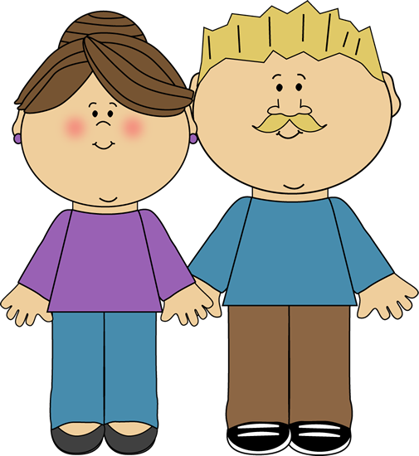
AT SOPHIE‘S HOUSE
Pri Sophie doma
JILL
JOE
FATHER
oče
MOTHER
mama

Slide 44


AT SOPHIE‘S HOUSE
Pri Sophie doma
DANA
BILL
GRANDMOTHER
babica
GRANDFATHER
dedek

Slide 45



AT SOPHIE‘S HOUSE
Pri Sophie doma
LILI
EDI
GRANDMOTHER
babica
GRANDFATHER
dedek

Slide 46


AT SOPHIE‘S HOUSE
Pri Sophie doma
PAM
ROGER
AUNT
teta
UNCLE
stric

Slide 47
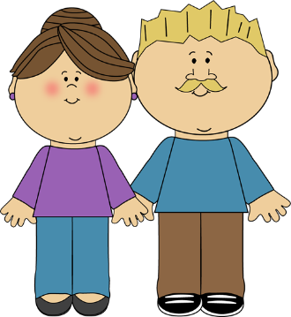



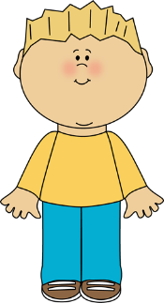

FAMILY TREE
Družinsko drevo
JILL
JOE
ROGER
PAM
SARA
SOPHIE
TOM

Slide 48



FAMILY TREE
Družinsko drevo
DANA
BILL
LILI
EDI
JILL
JOE
ROGER
PAM
SARA
SOPHIE
TOM

Slide 49
?
ASK ME ANYTHING.
TIME FOR
QUESTIONS
Čas za vprašanja

Slide 50
FAMILY

Slide 51
7
KNOCK
potrkati
KNOCK ON THE SCREEN

Slide 52

FOOD and DRINKS
Hrana in pijača

Slide 53

AT THE MARKET
Na tržnici
LET‘S GO TO THE MARKET.
 bananas
 tomatoes
 cherries
 onions
 potatoes
 apples
 strawberries

Slide 54

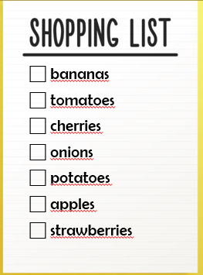

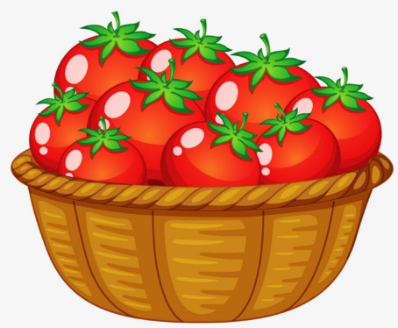



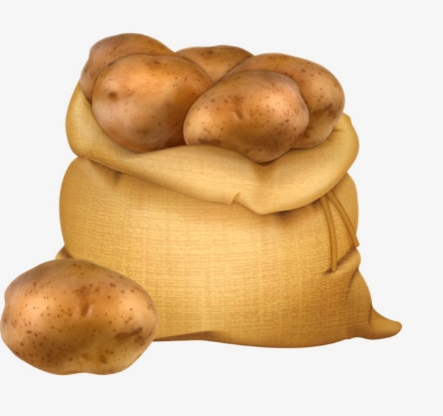

AT THE MARKET
Na tržnici

Slide 55

AT THE MARKET
Na tržnici
 bananas
 tomatoes
 cherries
 onions
 potatoes
 apples
 strawberries

Slide 56
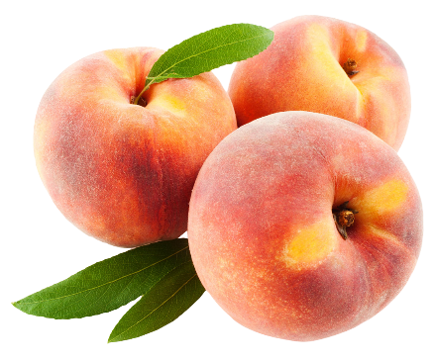


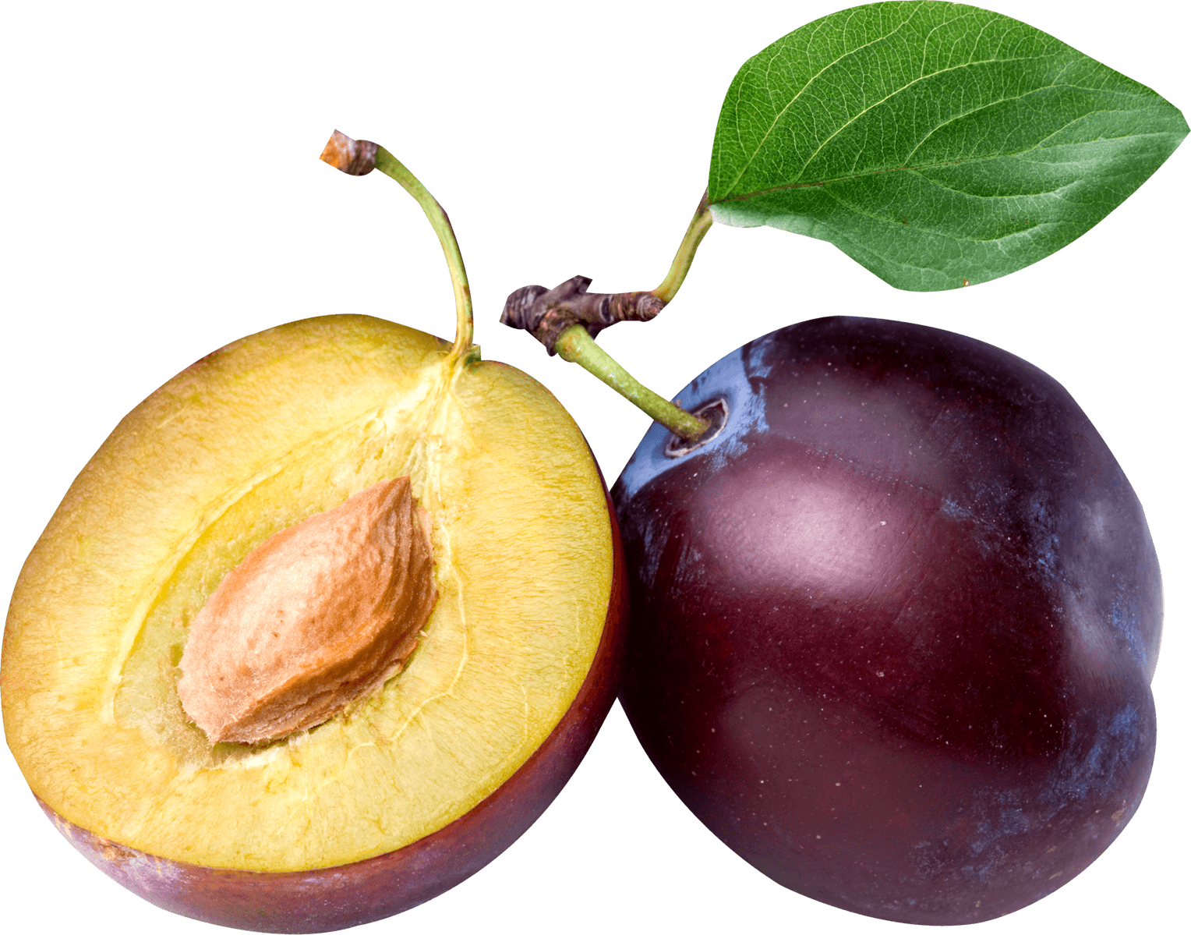

FRUIT AND VEGETABLES
Sadje in zelenjava
BANANA
banana
PEACH
breskev
PEAR
hruška
STRAWBERRY
jagoda
BLUEBERRY
borovnica
PLUM
sliva
WATERMELON
lubenica
APPLE
jabolko
APRICOT
marelica

Slide 57
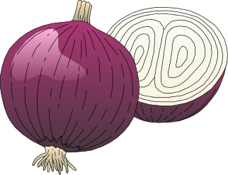




FRUIT AND VEGETABLES
Sadje in zelenjava
POTATO
krompir
ONION
čebula
LETTUCE
solata
GARLIC
česen
CARROT
korenje
TOMATO
paradižnik

Slide 58

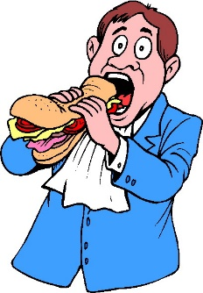
Are you hungry?
F
Ali si lačen/lačna?
TO BE HUNGRY
biti lačen
YES, VERY MUCH.
ARE YOU HUNGRY?
TO EAT
jesti

Slide 59
Are you hungry?
F
Ali si lačen/lačna?
TO BE HUNGRY
biti lačen
LET‘S GO EAT SOMETHING.
TO EAT
jesti

Slide 60



RESTAURANT
Restavracija
Pijače
Hrana

Slide 61
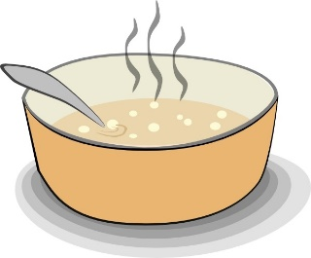






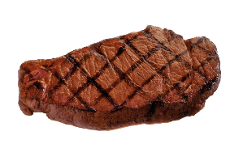

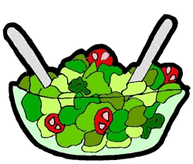
RESTAURANT
Restavracija
Hrana
SOUP
juha
ICE CREAM
sladoled
PIZZA
pica
HOT DOG
hot dog
PANCAKES
palačinke
CAKE
torta
PASTA
testenine
STEAK
zrezek
RICE
riž
SALAD
solata

Slide 62









RESTAURANT
Restavracija
Pijače
APPLE JUICE
jabolčni sok
MILK
mleko
COFFEE
kava
WATER
voda
ICED TEA
ledeni čaj
TEA
čaj
LEMONADE
limonada
HOT CHOCOLATE
vroča čokolada
ORANGE JUICE
pomarančni sok

Slide 63
PICK THE RIGHT ONE
F
Izberi pravo

Slide 64

FRUIT AND VEGETABLES
Sadje in zelenjava

Slide 65
?
ASK ME ANYTHING.
TIME FOR
QUESTIONS
Čas za vprašanja

Slide 66
FAMILY
FOOD and DRINKS

Slide 67
8
KNOCK
potrkati
KNOCK ON THE SCREEN

Slide 68
WHAT DO YOU WANT TO BE WHEN YOU GROW UP?

Slide 69

WHEN I GROW UP, I WANT TO BE A TEACHER.

Slide 70

WHEN I GROW UP, I WANT TO BE A POLICEMAN.

Slide 71

JOBS
Poklici

Slide 72

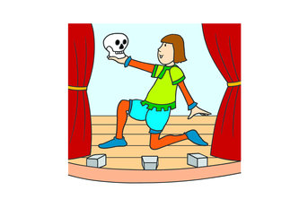
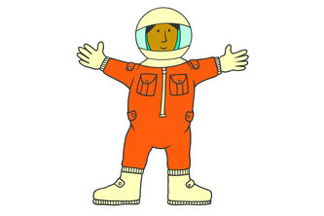
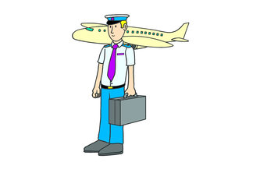
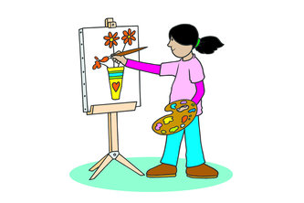
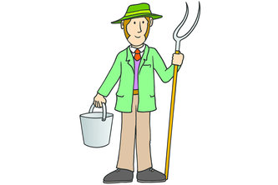

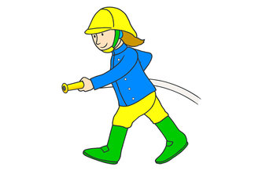



JObs
Poklici
FIND PAIRS
Poišči pare

Slide 74



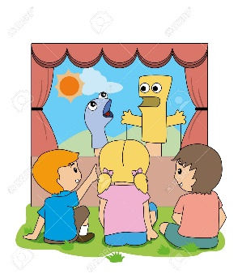
JObs
Poklici
TEACHER
učitelj/ica
SCHOOL
šola
CHALK
kreda
ACTOR
igralec
STAGE
oder
SHOW
predstava

Slide 75


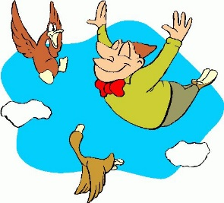

JObs
Poklici
ASTRONAUT
astronavt
SPACE
vesolje
ROCKET
raketa
PILOT
pilot
AIRPLANE
letalo
TO FLY
leteti

Slide 76

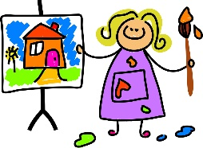

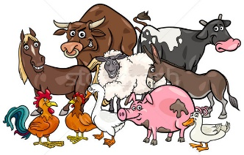
JObs
Poklici
PAINTER
1.slikar/ka
2. slikopleskar/ka
CANVAS
slikarsko
platno
TO PAINT
slikati
FARMER
kmet
  FARM
  kmetija
ANIMALS
živali

Slide 77

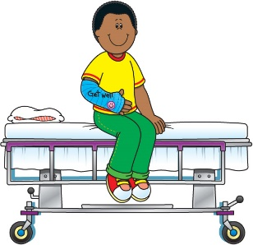

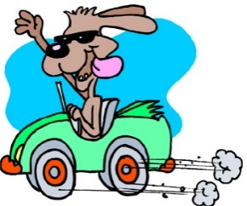
JObs
Poklici
  DOCTOR
zdravnik/zdravnica
PATIENT
pacient
HOSPITALbolnišnica
TAXI-DRIVER
taksist/ka
CAR
avto
TO DRIVE
voziti

Slide 78




JObs
Poklici
  POLICE OFFICER
  policist/ka
SIREN
sirena
POLICE CAR
policijski avto
FIREFIGHTER
gasilec/ka
TO HELP
pomagati
FIRE
ogenj, požar

Slide 79
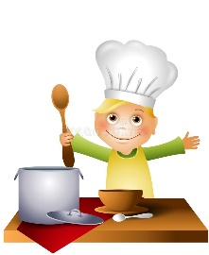
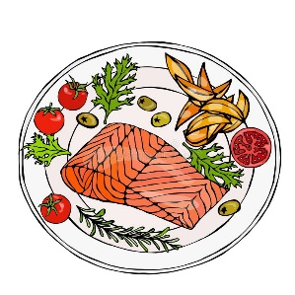
JObs
Poklici
  COOK
kuhar/ica
TO COOK
kuhati
MEAL
obrok

Slide 80


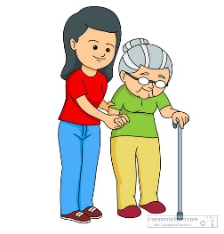

WHO DOES WHAT?
Kdo dela kaj?
TO EXTINGUISH
pogasiti
________ PAINTS ON CANVAS.
________ EXTINGUISHES FIRE.
TO HELP
pomagati
________ HELPS PATIENTS.

Slide 81
WHO DOES WHAT?
Kdo dela kaj?
TO ACT
igrati
________ COOKS MEALS.
________ FLIES WITH AN AIRPLANE.
________ ACTS SHOW ON THE STAGE.

Slide 82


WHO DOES WHAT?
Kdo dela kaj?
TO TEACH
poučevati
________ WORKS ON THE FARM.
________ TEACHES IN SCHOOL.
TO EXPLORE
raziskovati
________ IS EXPLORING THE SPACE.

Slide 83
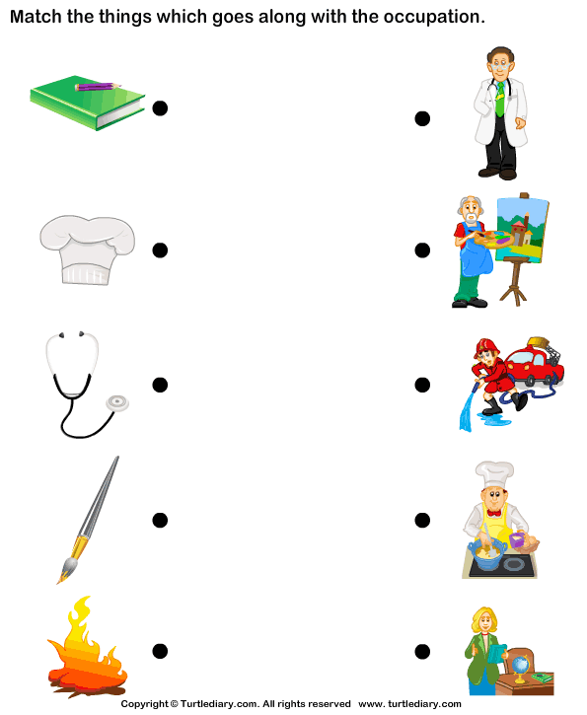



CHEF HAT
kuharska kapa
BRUSH
čopič
NOTEBOOK
zvezek
STETHOSCOP
stetoskop

Slide 84
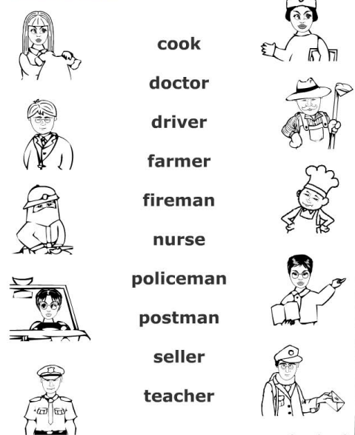


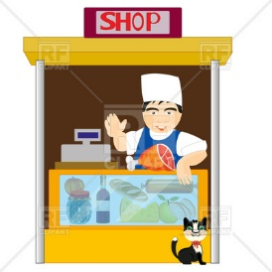
NURSE
medicinska sestra
POSTMAN
poštar
SELLER
prodajalec

Slide 85
?
ASK ME ANYTHING.
TIME FOR
QUESTIONS
Čas za vprašanja

Slide 86
FAMILY
JOBS
FOOD and DRINKS

Slide 87
9
KNOCK
potrkati
KNOCK ON THE SCREEN

Slide 88

MONTHS
Meseci

Slide 89
calendar
Koledar
HELLO JOHNNY!
HELLO SOPHIE!

Slide 90
calendar
Koledar
I AM LABELING BIRTHDAY DATES OF MY FRIENDS AND FAMILY.
WHAT ARE YOU DOING?

Slide 91
calendar
Koledar
OF COURSE JOHNNY, TAKE A LOOK!
CAN I SEE IT?

Slide 92





Slide 93











SEASONS
Letni časi
  SNOWFLAKE
  snežinka
WINTER
zima
SPRING
pomlad
  LEAF
  list
SUMMER
poletje
AUTUMN
jesen
  COLD
  mrzlo
  SEA
  morje
  HOT
  vroče

Slide 94











SEASONS
Letni časi
DURING THE WINTER
Pozimi

Slide 95






SEASONS
Letni časi
DURING SPRING
Spomladi

Slide 96






SEASONS
Letni časi
DURING SUMMER
Poleti

Slide 97





SEASONS
Letni časi
DURING AUTUMN
Jeseni

Slide 98
SEASONS
Letni časi
WINTER
zima
SPRING
pomlad
SUMMER
poletje
AUTUMN
jesen
W
zima
januar
februar
april
oktober
marec
junij
julij
maj
avgust
september
november
december

Slide 99
SEASONS
Letni časi
WINTER
zima
SPRING
pomlad
SUMMER
poletje
AUTUMN
jesen
W
zima
januar
februar
april
oktober
marec
junij
julij
maj
avgust
september
november
december

Slide 100

MONTHS
Meseci
WINTER
zima
januar
JANUARY
februar
FEBRUARY
december
DECEMBER

Slide 101




MONTHS
Meseci
januar
JANUARY
HAVE FUN
zabavati se
FIREWORK
ognjemet
NEW YEAR
Novo leto
MIDNIGHT
polnoč

Slide 102



MONTHS
Meseci
februar
FEBRUARY
Zdravljica
BIRTHDAY
rojstni dan
HYMN
himna
France Prešeren

Slide 103


MONTHS
Meseci
december
DECEMBER
CHRISTMAS
božič
CHRISTMAS TREE
božično drevo
ST. NICHOLAS
Miklavž
SANTA
Božiček
GIFT
darilo

Slide 104
SEASONS
Letni časi
WINTER
zima
SPRING
pomlad
SUMMER
poletje
AUTUMN
jesen
W
zima
januar
februar
april
oktober
marec
junij
julij
maj
avgust
september
november
december

Slide 105

MONTHS
Meseci
SPRING
zima
marec
MARCH
april
APRIL
maj
MAY

Slide 106



MONTHS
Meseci
marec
MARCH
CARD
voščilnica
MOTHER‘S DAY
materinski dan
BOUQUET
šopek

Slide 107



MONTHS
Meseci
april
APRIL
EASTER
velika noč
LIGHTS
luči
EARTH DAY
dan Zemlje
TURN OFF
ugasniti

Slide 108



MONTHS
Meseci
maj
MAY
BEE
čebela
praznik dela
WORLD BEE DAY
svetovni dan čebel

Slide 109
SEASONS
Letni časi
WINTER
zima
SPRING
pomlad
SUMMER
poletje
AUTUMN
jesen
W
zima
januar
februar
april
oktober
marec
junij
julij
maj
avgust
september
november
december

Slide 110

MONTHS
Meseci
SUMMER
poletje
junij
JUNE
julij
JULY
avgust
AUGUST

Slide 111


MONTHS
Meseci
junij
JUNE
  NATIONAL DAY
  dan državnosti
  SCHOOL
  šola
  END
  konec

Slide 112


MONTHS
Meseci
julij
JULY
avgust
AUGUST
  VACATIONS
  počitnice
  SEASIDE
  morska obala

Slide 113
SEASONS
Letni časi
WINTER
zima
SPRING
pomlad
SUMMER
poletje
AUTUMN
jesen
W
zima
januar
februar
april
oktober
marec
junij
julij
maj
avgust
september
november
december

Slide 114

MONTHS
Meseci
AUTUMN
jesen
september
SEPTEMBER
oktober
OCTOBER
november
NOVEMBER

Slide 115
MONTHS
Meseci
september
SEPTEMBER
  SCHOOL
  šola

Slide 116


MONTHS
Meseci
oktober
OCTOBER
november
NOVEMBER
  PRIMOŽ TRUBAR
  REFORMATION DAY
  dan reformacije

Slide 117
MONTHS
Meseci
WINTER
zima
SPRING
pomlad
SUMMER
poletje
AUTUMN
jesen
W
zima
JANUARY
OCTOBER
FEBRUARY
APRIL
MARCH
JUNE
JULY
MAY
AUGUST
SEPTEMBER
NOVEMBER
DECEMBER

Slide 118

MIXED UP MONTHS
Zmešani meseci
  JANUARY
  FEBRUARY
  MARCH
  APRIL
  MAY
  JUNE
  JULY
  AUGUST
  SEPTEMBER
  OCTOBER
  NOVEMBER
  DECEMBER

Slide 119
?
ASK ME ANYTHING.
TIME FOR
QUESTIONS
Čas za vprašanja

Slide 120
FAMILY
JOBS
FOOD and DRINKS
MONTHS

Slide 121
LET‘S REVISE
PONOVIMO

Slide 122



















COMPLETE MESS
Popolna zmešnjava
WHAT GOES TOGETHER?
Kaj gre skupaj?
EIGHT (osem)
THREE (tri)
ONE (ena)
TEN (deset)

Slide 123
COMPLETE MESS
Popolna zmešnjava
NUMBERS | COLOURS | SEASONS and MONTHS | ANIMALS | FAMILY | FOOD and DRINKS | JOBS

Slide 124
COMPLETE MESS
Popolna zmešnjava
WHAT GOES TOGETHER?
Kaj gre skupaj?
EIGHT (osem)
THREE (tri)
ONE (ena)
TEN (deset)

Slide 125
COMPLETE MESS
Popolna zmešnjava
NUMBERS | COLOURS | SEASONS and MONTHS | ANIMALS | FAMILY | FOOD and DRINKS | JOBS
ONE (ena)
THREE (tri)
EIGHT (osem)
TEN (deset)

Slide 126
COMPLETE MESS
Popolna zmešnjava
WHAT GOES TOGETHER?
Kaj gre skupaj?

Slide 127
COMPLETE MESS
Popolna zmešnjava
NUMBERS | COLOURS | SEASONS and MONTHS | ANIMALS | FAMILY | FOOD and DRINKS | JOBS
ONE (ena)
THREE (tri)
EIGHT (osem)
TEN (deset)

Slide 128
COMPLETE MESS
Popolna zmešnjava
WHAT GOES TOGETHER?
Kaj gre skupaj?

Slide 129





COMPLETE MESS
Popolna zmešnjava
NUMBERS | COLOURS | SEASONS and MONTHS | ANIMALS | FAMILY | FOOD and DRINKS | JOBS
ONE (ena)
THREE (tri)
EIGHT (osem)
TEN (deset)

Slide 130
COMPLETE MESS
Popolna zmešnjava
WHAT GOES TOGETHER?
Kaj gre skupaj?

Slide 131








COMPLETE MESS
Popolna zmešnjava
NUMBERS | COLOURS | SEASONS and MONTHS | ANIMALS | FAMILY | FOOD and DRINKS | JOBS
ONE (ena)
THREE (tri)
EIGHT (osem)
TEN (deset)

Slide 132
COMPLETE MESS
Popolna zmešnjava
WHAT GOES TOGETHER?
Kaj gre skupaj?

Slide 133
COMPLETE MESS
Popolna zmešnjava
NUMBERS | COLOURS | SEASONS and MONTHS | ANIMALS | FAMILY | FOOD and DRINKS | JOBS
ONE (ena)
THREE (tri)
EIGHT (osem)
TEN (deset)

Slide 134
COMPLETE MESS
Popolna zmešnjava
WHAT GOES TOGETHER?
Kaj gre skupaj?

Slide 135
COMPLETE MESS
Popolna zmešnjava
NUMBERS | COLOURS | SEASONS and MONTHS | ANIMALS | FAMILY | FOOD and DRINKS | JOBS
ONE (ena)
THREE (tri)
EIGHT (osem)
TEN (deset)

Slide 136

ONE
REVISION
4
ONE | TWO | COW | MOUSE | SHARK |  | CAT
 | THREE | FOUR | FIVE | OCTOPUS | LION | RABBIT
 |  |  | SIX | SEVEN | EIGHT | NINE
 |  |  |  |  |  | TEN
 |  | BLACK | BROWN | YELLOW | PURPLE
RED | BLUE | GREEN |  |  | PINK | ORANGE
 |  |  | PAINTER | DOCTOR
TEACHER | COOK | FIREFIGHTER | POLICEMAN | NURSE | DRIVER | ASTRONAUT

Slide 137
ONE
REVISION
4
ONE | TWO | COW | MOUSE | SHARK |  | CAT
 | THREE | FOUR | FIVE | OCTOPUS | LION | RABBIT
 |  |  | SIX | SEVEN | EIGHT | NINE
 |  |  |  |  |  | TEN
 |  | BLACK | BROWN | YELLOW | PURPLE
RED | BLUE | GREEN |  |  | PINK | ORANGE
 |  |  | PAINTER | DOCTOR
TEACHER | COOK | FIREFIGHTER | POLICEMAN | NURSE | DRIVER | ASTRONAUT

Slide 138
ONE
REVISION
4
ONE | TWO | COW | MOUSE | SHARK |  | CAT
 | THREE | FOUR | FIVE | OCTOPUS | LION | RABBIT
 |  |  | SIX | SEVEN | EIGHT | NINE
 |  |  |  |  |  | TEN
 |  | BLACK | BROWN | YELLOW | PURPLE
RED | BLUE | GREEN |  |  | PINK | ORANGE
 |  |  | PAINTER | DOCTOR
TEACHER | COOK | FIREFIGHTER | POLICEMAN | NURSE | DRIVER | ASTRONAUT

Slide 139
ONE
REVISION
4
ONE | TWO | COW | MOUSE | SHARK |  | CAT
 | THREE | FOUR | FIVE | OCTOPUS | LION | RABBIT
 |  |  | SIX | SEVEN | EIGHT | NINE
 |  |  |  |  |  | TEN
 |  | BLACK | BROWN | YELLOW | PURPLE
RED | BLUE | GREEN |  |  | PINK | ORANGE
 |  |  | PAINTER | DOCTOR
TEACHER | COOK | FIREFIGHTER | POLICEMAN | NURSE | DRIVER | ASTRONAUT

Slide 140
ONE
REVISION
4
ONE | TWO | COW | MOUSE | SHARK |  | CAT
 | THREE | FOUR | FIVE | OCTOPUS | LION | RABBIT
 |  |  | SIX | SEVEN | EIGHT | NINE
 |  |  |  |  |  | TEN
 |  | BLACK | BROWN | YELLOW | PURPLE
RED | BLUE | GREEN |  |  | PINK | ORANGE
 |  |  | PAINTER | DOCTOR
TEACHER | COOK | FIREFIGHTER | POLICEMAN | NURSE | DRIVER | ASTRONAUT

Slide 141
ONE
REVISION
4
Numbers
ONE, TWO, THREE, FOUR, FIVE, SIX, SEVEN, EIGHT, NINE, TEN
Colours
RED, BLUE, GREEN, BLACK, BROWN, YELLOW, PURPLE, PINK, ORANGE
Animals
COW, MOUSE, SHARK, OCTOPUS, LION, RABBIT, CAT
Jobs
TEACHER, COOK, FIREFIGHTER, POLICEMAN, PAINTER, DOCTOR, NURSE, DRIVER, ASTRONAUT

Slide 142
WHAT IS MY NAME? | predstavitev | What is your name? My name is Sophie.
NUMBERS | štetje do 10 starost | One, two, three, four, five, six, seven, eight, nine, ten. How old are you? I am 7 years old.
COLOURS | barve moja najljubša barva | Red, blue, green, purple, pink, yellow, orange, brown, black, white, grey. What is your favorite colour? My favorite colour is blue.
SEASONS and MONTHS | letni časi značilnosti letnih časov meseci | WINTER (january, february, december)
 |  | SPRING (march, april, may)
 |  | SUMMER (june, july, august)
 |  | AUTUMN (september, october, november)

Slide 143
ANIMALS | domače živali živali v živalskem vrtu domače živali morske živali najljubša žival | FARM ANIMALS (cow)
 |  | ZOO ANIMALS (giraffe)
 |  | PETS (dog)
 |  | SEA ANIMALS (seahorse)
 |  | What is your favorite animal? My favorite animal is dog.
FAMILY | družinski člani | Sister, brother, mother, father, grandmother, grandfather, uncle, aunt, cousin.
FOOD and DRINKS | sadje in zelenjava hrana v restavraciji pijača | FRUITS and VEGETABLES (cherry, letucce)
 |  | FOOD IN RESTAURANT (pizza)
 |  | DRINKS (lemonade)
JOBS | poklici | Teacher, astronaut, painter, postman, policeman etc.

Slide 144

ONE
PRIPOROČENE SPLETNE STRANI
ESL KIDS STUFF: https://www.eslkidstuff.com /

Slide 145

ONE
PRIPOROČENE SPLETNE STRANI
ENGLISH EXERCISES: http://www.englishexercises.org /

Slide 146

ONE
PRIPOROČENE SPLETNE STRANI
WORK SHEETS FUN: http://www.worksheetfun.com /

Slide 147

ONE
PRIPOROČENE SPLETNE STRANI
ANGLIOMANIACY: https://anglomaniacy.pl

Slide 148

ONE
PRIPOROČENE SPLETNE STRANI
TEACH ENGLISH STEP BY STEP: http://www.teachenglishstepbystep.com/

Slide 149
NUMBERS
1
2
3
WHAT‘S YOUR NAME?
COLOURS
5
4
6
ANIMALS
SEASONS
8
FAMILY
7
MONTHS
9
FOOD and DRINKS
JOBS

Slide 150

WELL DONE!

Slide 151


