Slide 1
ANGLEŠČINA ZA OTROKE
1. termin
My very first english

Slide 2
LEGENDA SIMBOLOV
KNOCK
potrkati

Slide 3
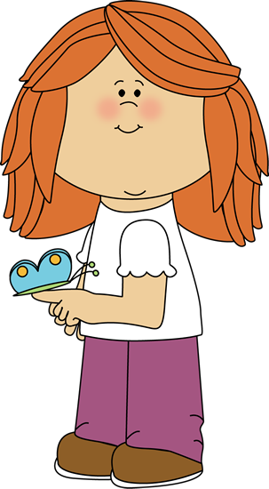
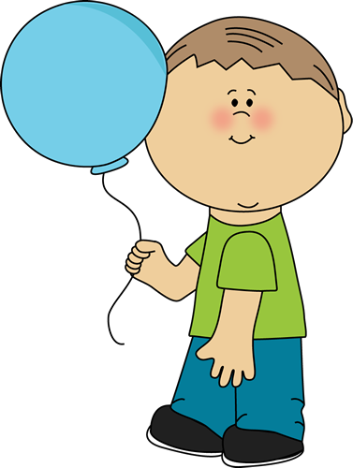
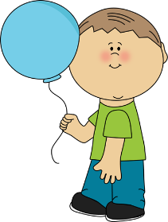
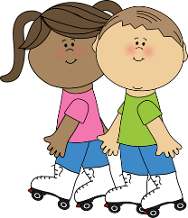
ADVENTURE
pustolovščina
GIRL
deklica
SOPHIE
JOHNNY
BOY
deček
FRIEND
prijatelj

Slide 4
1
2
3
START
začetek
5
LETTER
pismo
4
6
FINISH
cilj
8
7
9

Slide 5
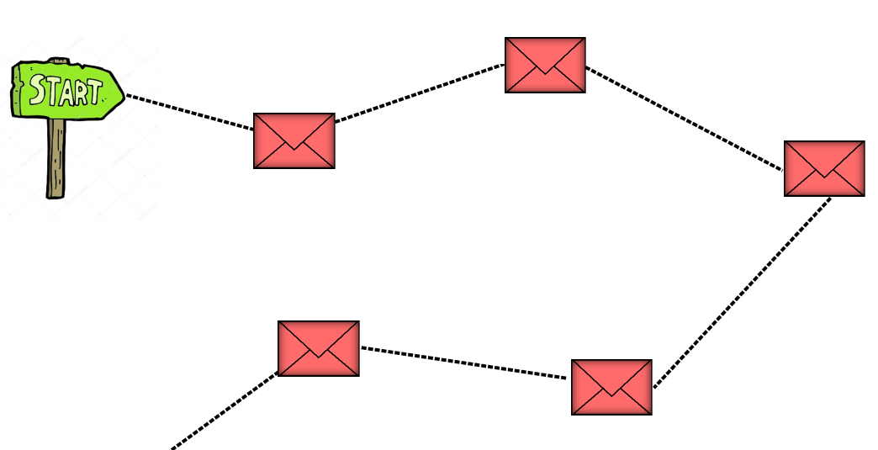
1
2
3
5
4

Slide 6
1
KNOCK
potrkati
KNOCK ON THE SCREEN

Slide 7
WHAT IS YOUR NAME
?
Kako ti je ime?

Slide 8
WHAT IS YOUR NAME ?
Kako ti je ime?
HELLO
pozdravljen/a
HELLO!
HELLO!

Slide 9
WHAT IS YOUR NAME ?
Kako ti je ime?
MY NAME IS SOPHIE.

Slide 10
WHAT IS YOUR NAME ?
Kako ti je ime?
WHAT IS YOUR NAME ?
MY NAME IS JOHNNY.

Slide 11
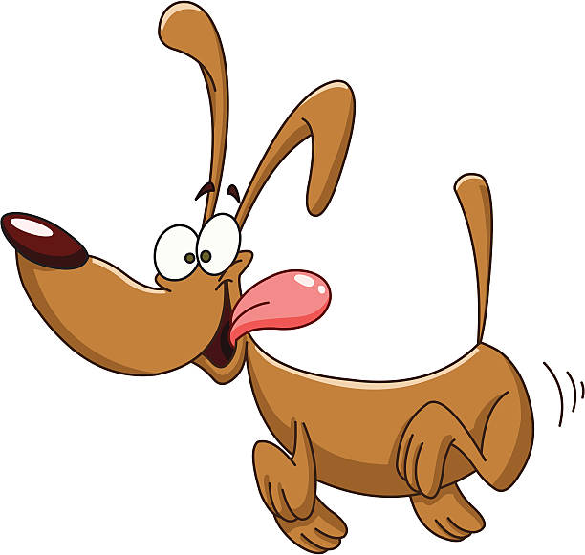
WHAT IS YOUR NAME ?
Kako ti je ime?
HELLO!
WHAT IS YOUR NAME ?
MY NAME IS LOU.
WOF WOF

Slide 12
WHAT IS YOUR NAME ?
Kako ti je ime?
WHAT IS YOUR NAME ?
MY NAME IS ___________.
Ime mi je ________.

Slide 13
WHAT‘S YOUR NAME?
Kako ti je ime?
https://www.youtube.com/watch?v=twz_tWU6_mM

Slide 14
WHAT‘S YOUR NAME?
Kako ti je ime?
HOW MANY NAMES?
Koliko imen?
1
2
3
4
5

Slide 15
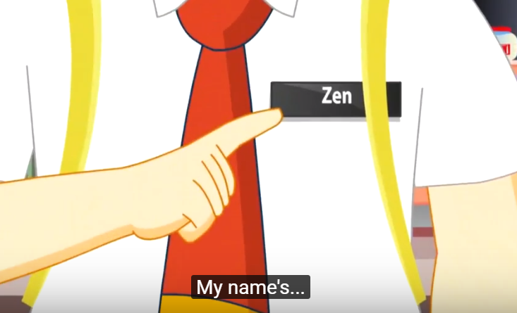
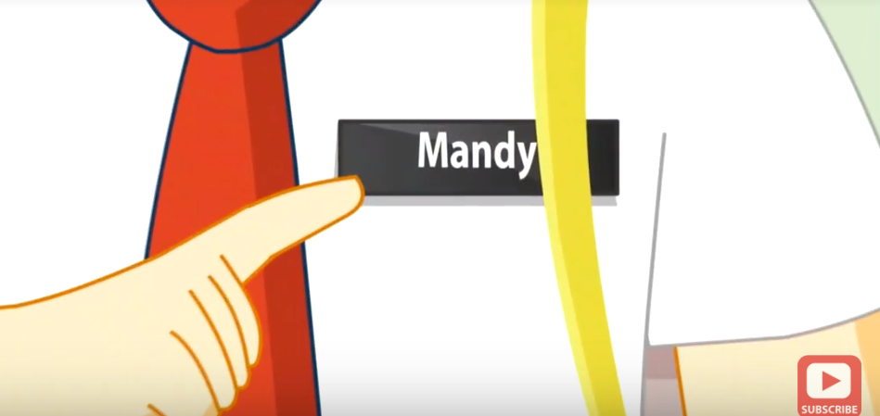
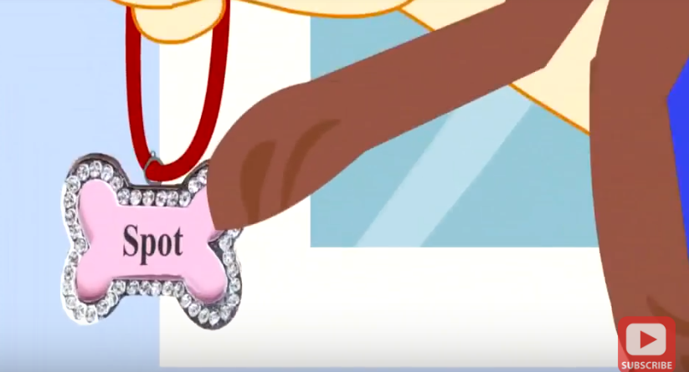
WHAT‘S YOUR NAME?
Kako ti je ime?
HOW MANY NAMES?
Koliko imen?

Slide 16
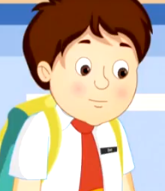
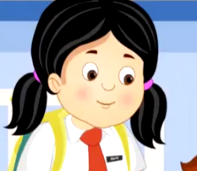
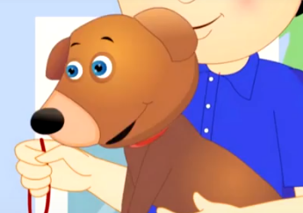
WHAT‘S YOUR NAME?
Kako ti je ime?
ZEN MANDY SPOT
MY NAME IS ZEN .
MY NAME IS MANDY.
MY NAME IS SPOT.
WHAT IS YOUR NAME ?

Slide 17
?
ASK ME ANYTHING.
TIME FOR
QUESTIONS
Čas za vprašanja

Slide 18
1
2
3
WHAT‘S YOUR NAME?
5
4

Slide 19
2
KNOCK
potrkati
KNOCK ON THE SCREEN

Slide 20
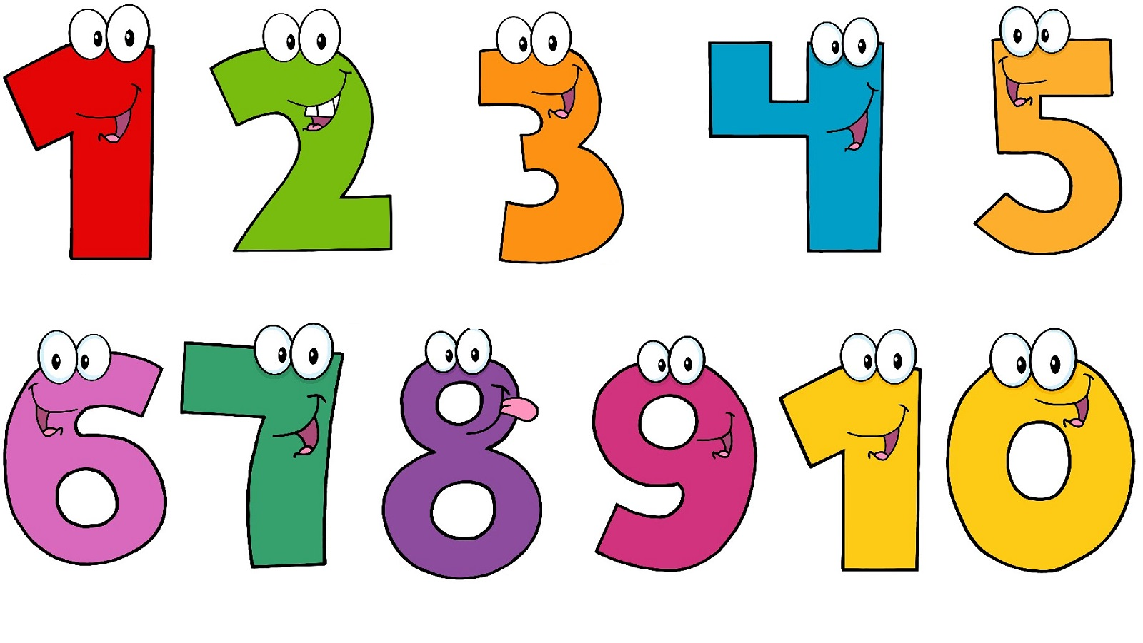
NUMBERS (HOW MANY?)
Številke

Slide 21
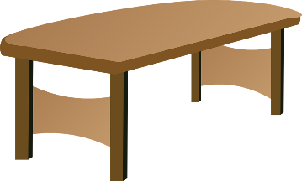
NUMBERS (HOW MANY?)
Številke
PENCIL
svinčnik
HOW MANY PENCILS ARE THERE ON THE TABLE?
Koliko svinčnikov je na mizi?
TABLE
miza

Slide 22
NUMBERS (HOW MANY?)
Številke
1
PENCIL
svinčnik
ONE PENCIL
TABLE
miza

Slide 23
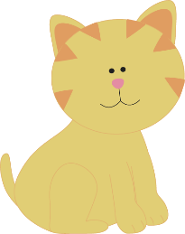
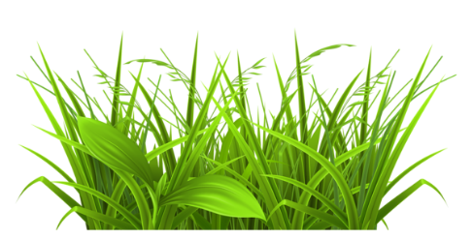
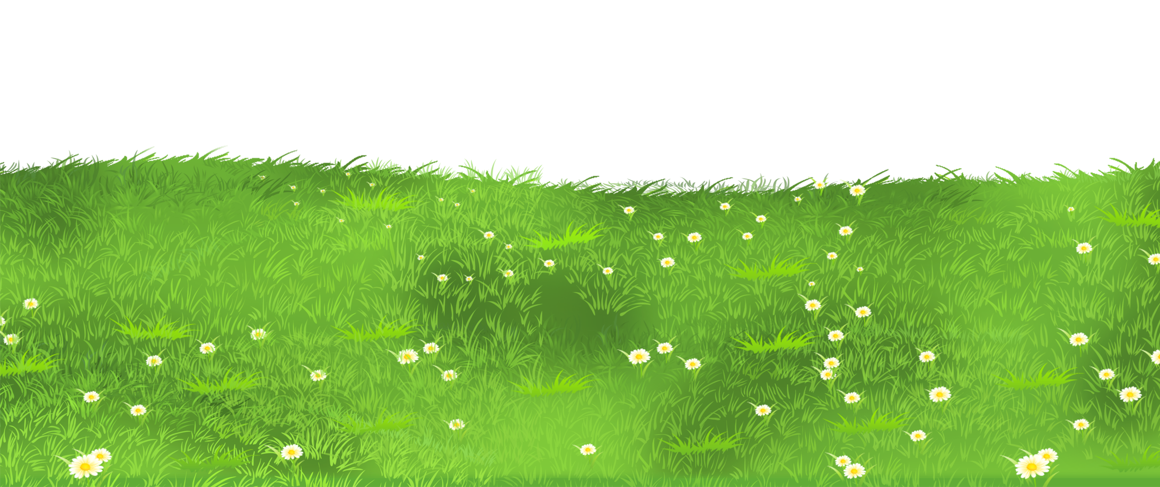
NUMBERS (HOW MANY?)
Številke
CAT
mačka
HOW MANY CATS ARE ON THE GRASS?
Koliko mačk je na travi?
GRASS
trava

Slide 24
NUMBERS (HOW MANY?)
Številke
CAT
mačka
HOW MANY CATS ARE ON THE GRASS?
Koliko mačk je na travi?
GRASS
trava

Slide 25
NUMBERS (HOW MANY?)
Številke
2
CAT
mačka
TWO CATS
GRASS
trava

Slide 26
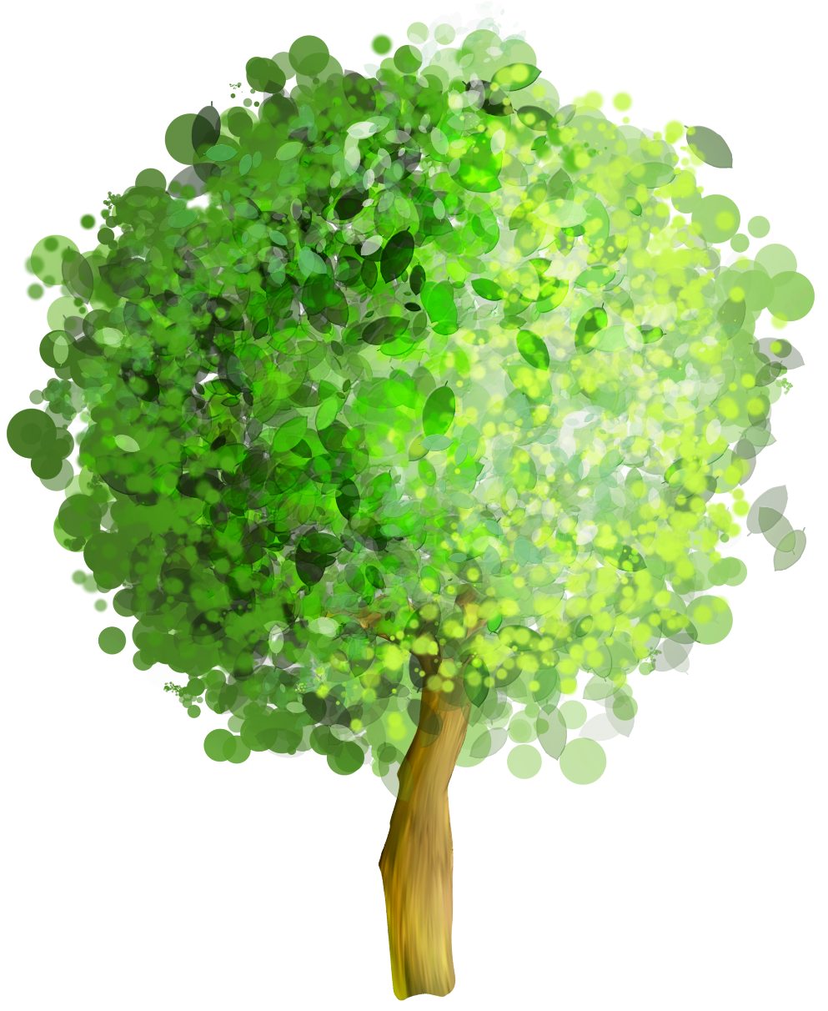
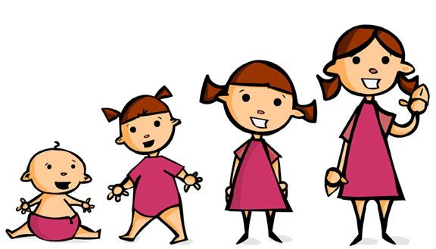
NUMBERS (HOW MANY?)
Številke (Koliko?)
APPLE
jabolko
HOW MANY APPLES GROW IN THE TREE?
Koliko jabolk raste na drevesu?
TREE
drevo
GROW
rasti

Slide 27
NUMBERS (HOW MANY?)
Številke (Koliko?)
3
APPLE
jabolko
TREE
drevo
THREE APPLES
GROW
rasti

Slide 28
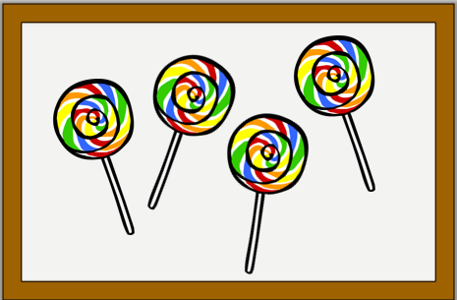
NUMBERS (HOW MANY?)
Številke (Koliko?)
LOLLIPOP
lizika
HOW MANY LOLLIPOPS ARE IN THE PICTURE?
Koliko lizik je na sliki?
PICTURE
slika

Slide 29
NUMBERS (HOW MANY?)
Številke (Koliko?)
LOLLIPOP
lizika
4
PICTURE
slika
FOUR LOLLIPOPS

Slide 30
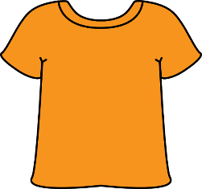
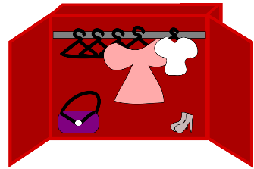
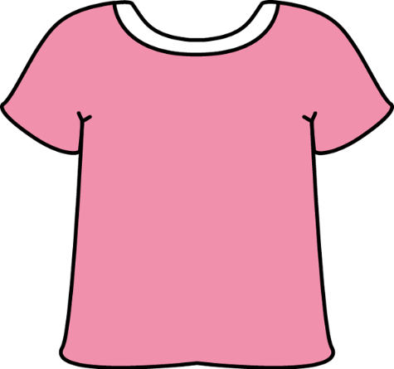
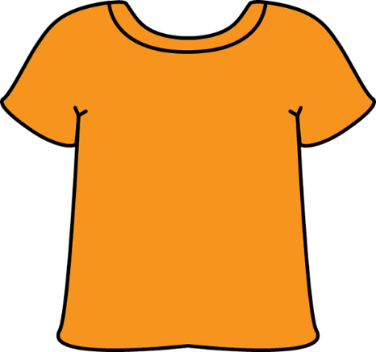
NUMBERS (HOW MANY?)
Številke (Koliko?)
SHIRT
majica
HOW MANY SHIRTS ARE IN THE CLOSET?
Koliko majic je v omari?
CLOSET
omara

Slide 31
NUMBERS (HOW MANY?)
Številke (Koliko?)
SHIRT
majica
5
CLOSET
omara
FIVE SHIRTS

Slide 32
NUMBERS (HOW MANY?)
Številke (Koliko?)
BIRD
ptica
HOW MANY BIRDS ARE ON THE BRANCH?
Koliko ptic je na veji?
BRANCH
veja

Slide 33
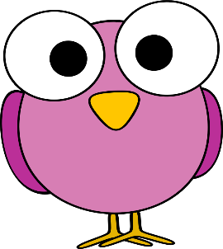
NUMBERS (HOW MANY?)
Številke (Koliko?)
6
BIRD
ptica
BRANCH
veja
SIX BIRDS

Slide 34
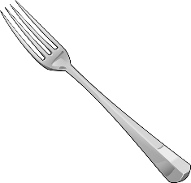
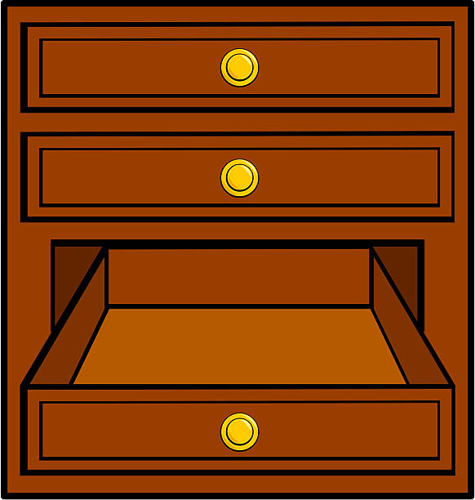
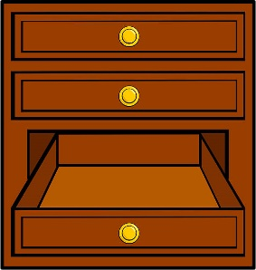
NUMBERS (HOW MANY?)
Številke (Koliko?)
FORK
vilice
HOW MANY FORKS ARE IN THE DRAWER?
Koliko vilic je v predalu?
DRAWER
predal

Slide 35
NUMBERS (HOW MANY?)
Številke (Koliko?)
FORK
vilice
7
DRAWER
predal
SEVEN FORKS

Slide 36
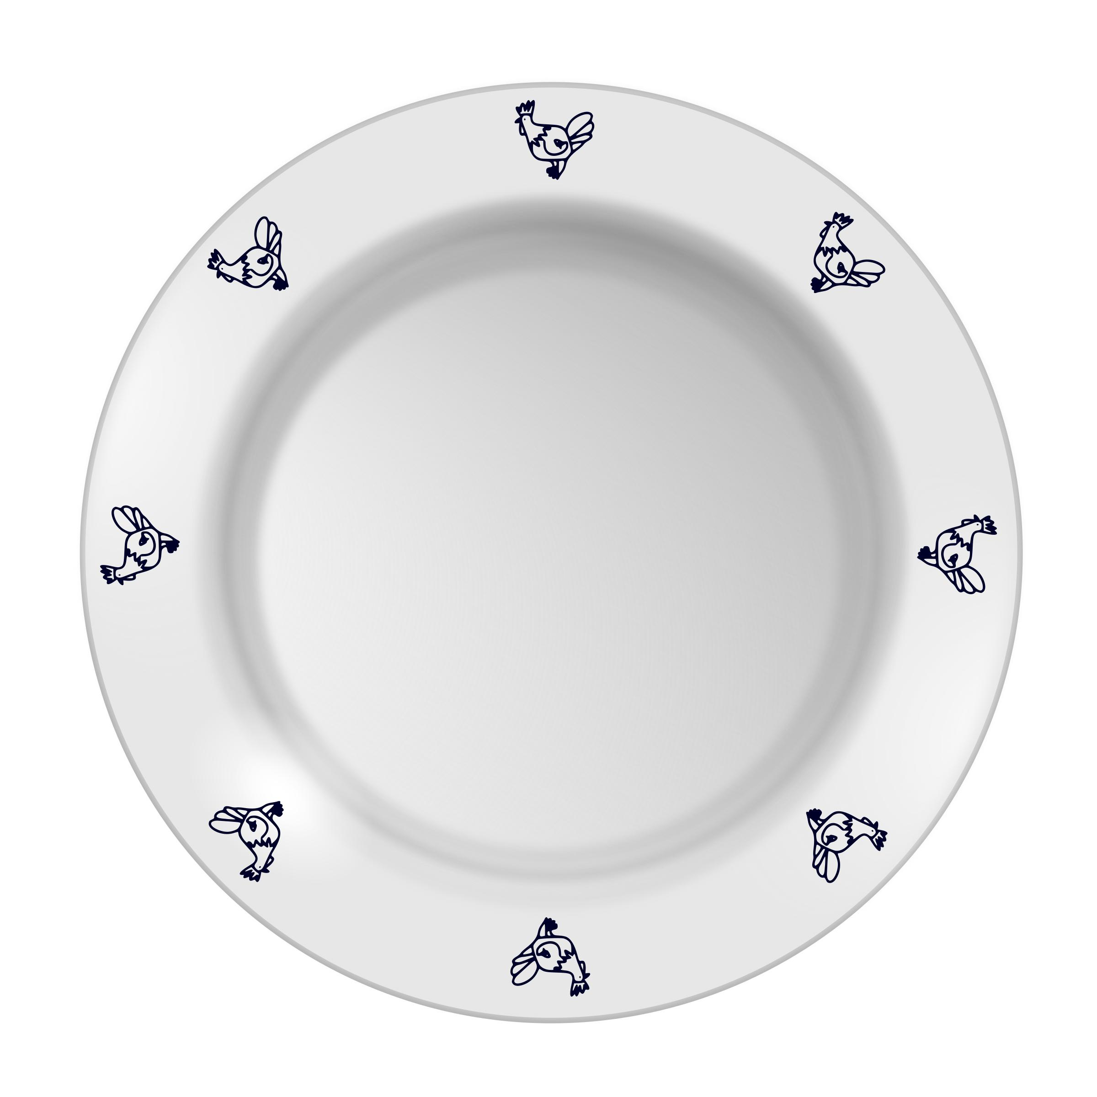
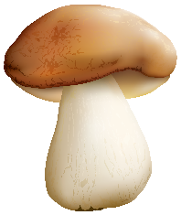
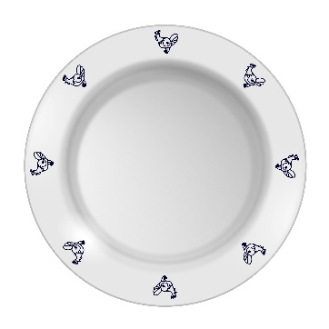
NUMBERS (HOW MANY?)
Številke (Koliko?)
MUSHROOM
goba
HOW MANY MUSHROOMS ARE ON THE PLATE?
Koliko gob je na krožniku?
PLATE
krožnik

Slide 37
NUMBERS (HOW MANY?)
Številke (Koliko?)
8
MUSHROOM
goba
PLATE
krožnik
EIGHT MUSHROOMS

Slide 38
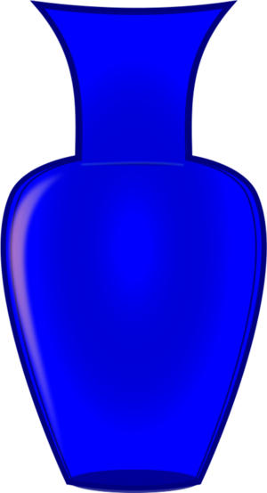
NUMBERS (HOW MANY?)
Številke (Koliko?)
FLOWER
cvetlica
HOW MANY FLOWERS ARE IN THE VASE?
Koliko cvetlic je v vazi?
VASE
vaza

Slide 39
NUMBERS (HOW MANY?)
Številke (Koliko?)
9
FLOWER
cvetlica
VASE
vaza
NINE FLOWERS

Slide 40
NUMBERS (HOW MANY?)
Številke (Koliko?)
STAR
zvezda
HOW MANY STARS ARE IN THE SKY?
Koliko zvezd je na nebu?
SKY
nebo

Slide 41
NUMBERS (HOW MANY?)
Številke (Koliko?)
10
STAR
zvezda
SKY
nebo
TEN STARS

Slide 42
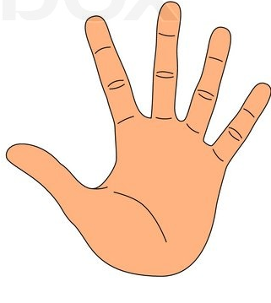
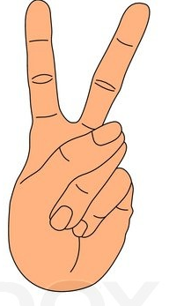
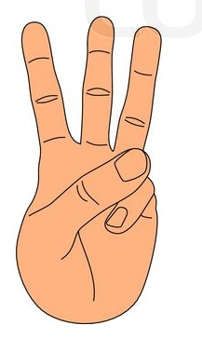
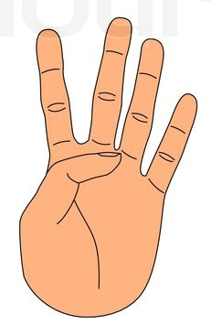
LET‘S COUNT WITH FINGERS
Štejmo s prsti
ONE (ena)
SIX (šest)
TWO (dva)
SEVEN (sedem)
THREE (tri)
EIGHT (osem)
FOUR (štiri)
NINE (devet)
FIVE (pet)
TEN (deset)

Slide 43
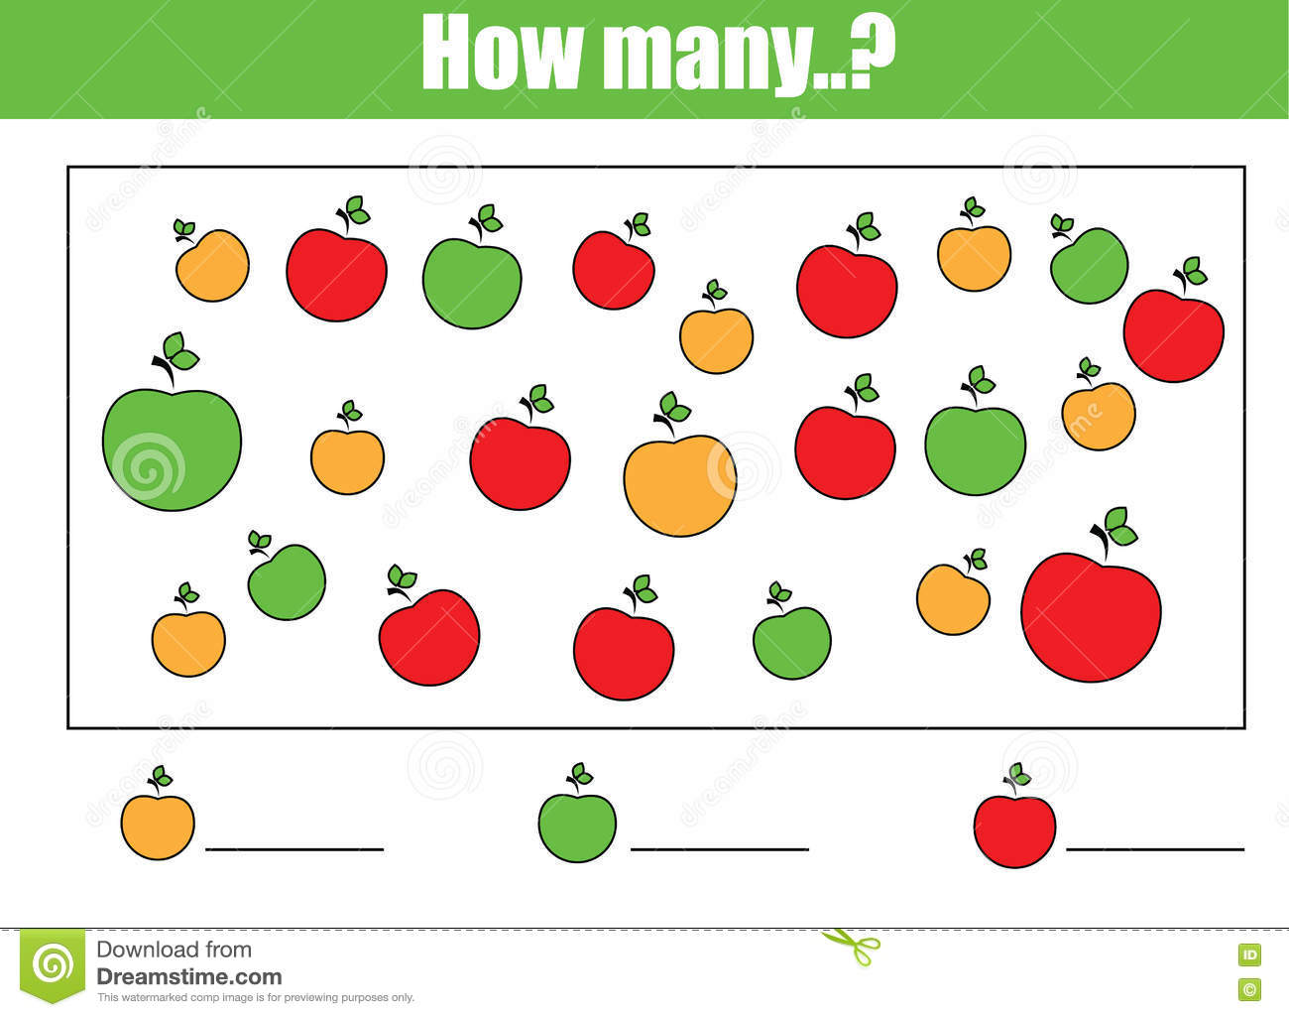
HOW MANY?
Koliko?

Slide 44
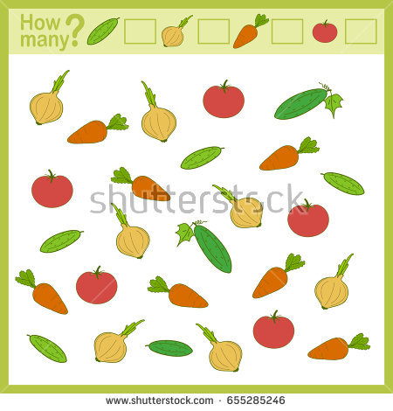
HOW MANY?
Koliko?
7
7
7
5

Slide 45
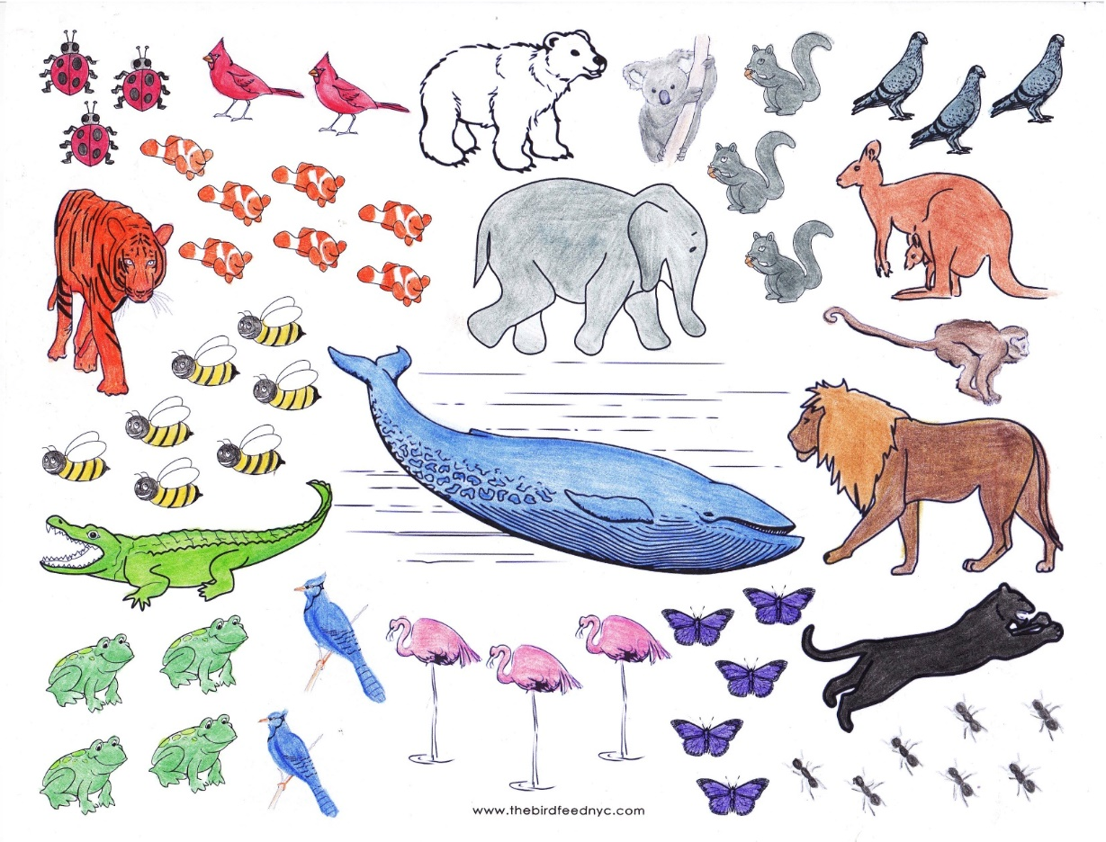
http://thebirdfeednyc.com/2013/02/18/animals-coloring-and-counting-activity-sheet/
COUNT THE ANIMALS
LADYBUG
pikapolonica
Preštej živali
HOW MANY?
3
BUTTERFLY
metulj
5
1
CROCODILE
krokodil
7
2
BEE
čebela
7
4
BIRD
ptica
ANT
mravlja
FROG
žaba

Slide 46
HOW OLD ARE YOU?
Koliko si star?
HOW OLD ARE YOU?
I AM 8 YEARS OLD.

Slide 47
HOW OLD ARE YOU?
Koliko si star?
HOW OLD ARE YOU?
I AM ____ YEARS OLD.
Star/a sem ____ let.

Slide 48
?
ASK ME ANYTHING.
TIME FOR
QUESTIONS
Čas za vprašanja

Slide 49
NUMBERS
1
2
3
WHAT‘S YOUR NAME?
5
4

Slide 50
3
KNOCK
potrkati
KNOCK ON THE SCREEN

Slide 51
COLORS
Barve

Slide 52
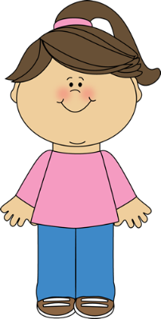
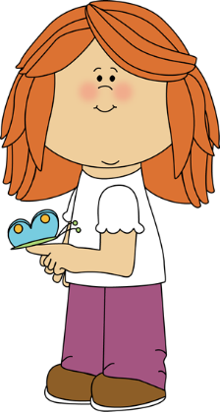
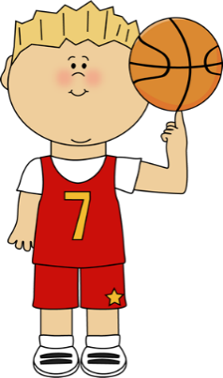
COLORS
rdeča
oranžna
rumena
roza
zelena
modra
vijolična

Slide 53
COLORS
rjava

Slide 54
COLORS

Slide 55
COLORS

Slide 56
COLORS
bela
siva
črna

Slide 57
COLORS
rdeča
RED
oranžna
ORANGE
rumena
YELLOW
zelena
roza
GREEN
PINK
modra
BLUE
vijolična
PURPLE

Slide 58
COLORS
BROWN
rjava

Slide 59
COLORS

Slide 60
COLORS

Slide 61
COLORS
bela
WHITE
GREY
siva
črna
BLACK

Slide 62
COLORS
RAINBOW
mavrica
HELP US SAVE THE RAINBOW!
Pomagajte nam rešiti mavrico!

Slide 63
COLORS
RAINBOW
mavrica
HOW TO SAVE THE RAINBOW?
Kako rešiti mavrico?
FIND CIRCLES IN 7 DIFFERENT COLORS.
CIRCLE
krog
Poišči kroge v 7 različnih barvah.

Slide 64
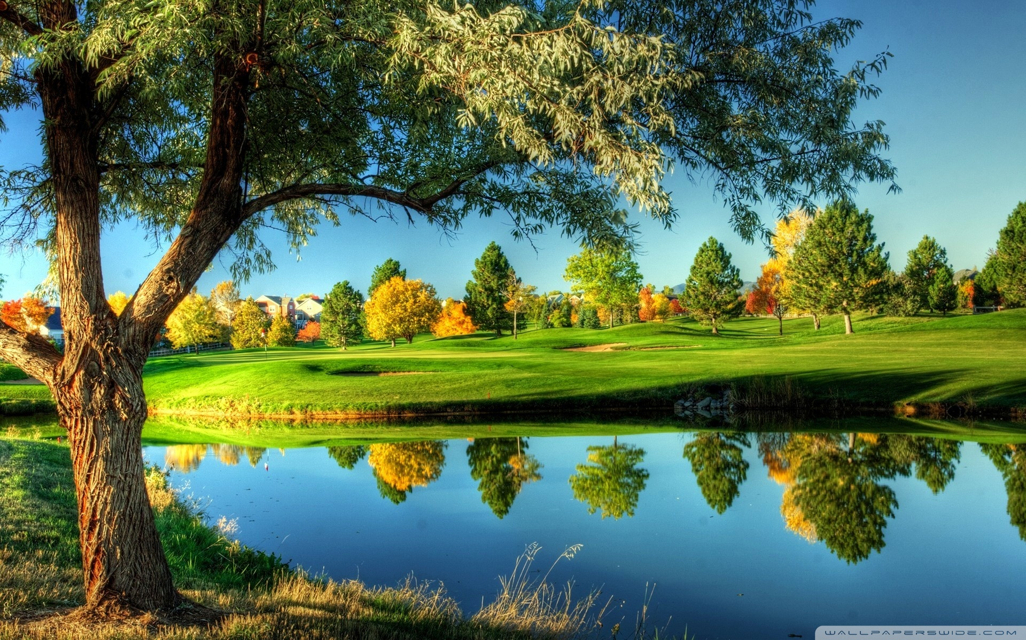
COLORS

Slide 65
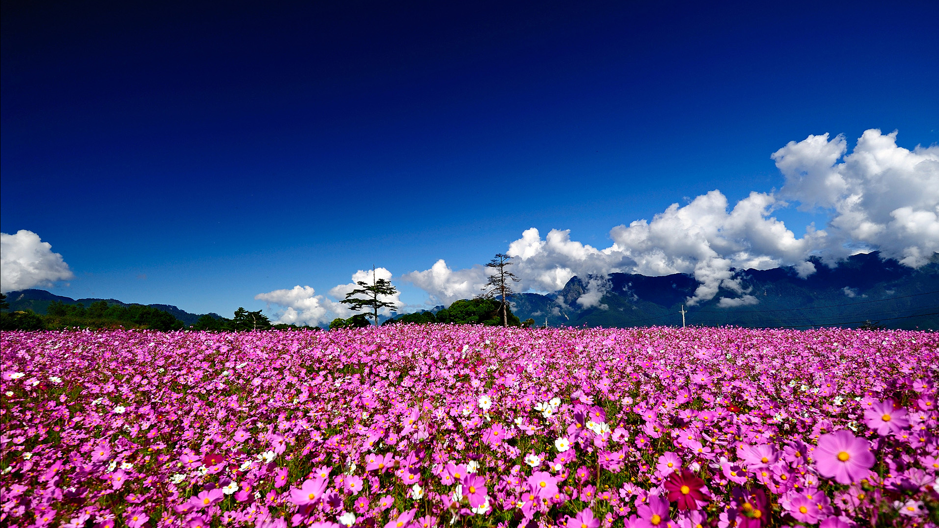
COLORS

Slide 66
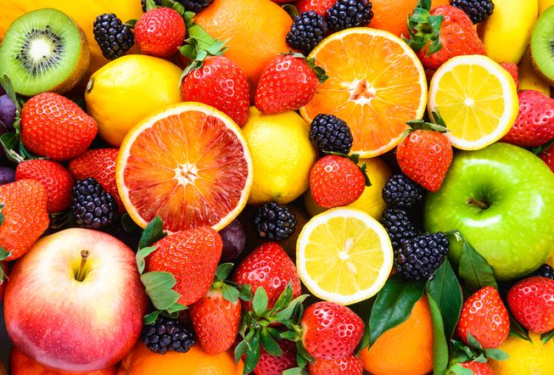
COLORS

Slide 67
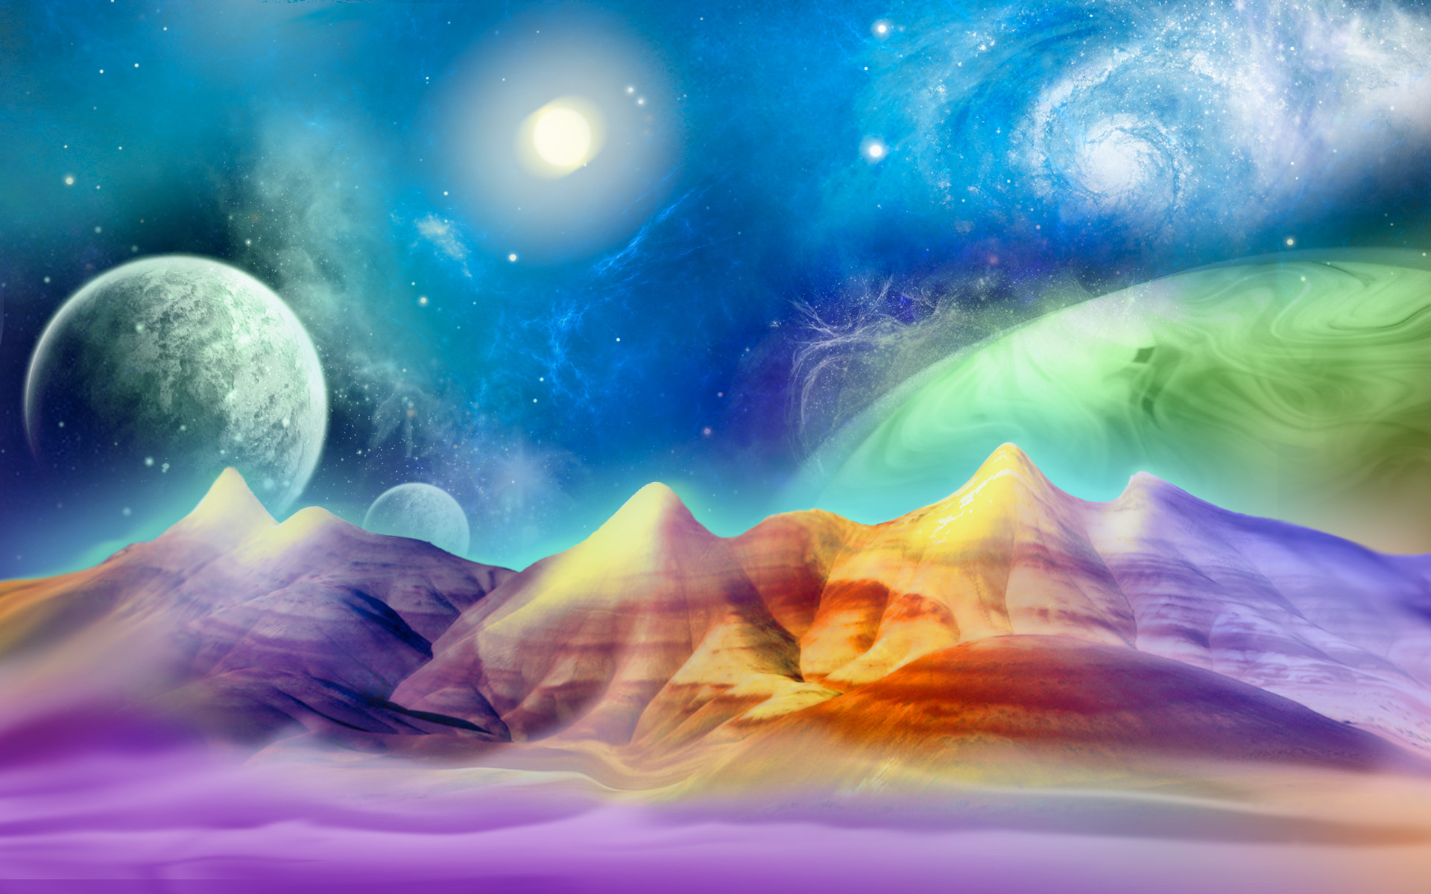
COLORS

Slide 68
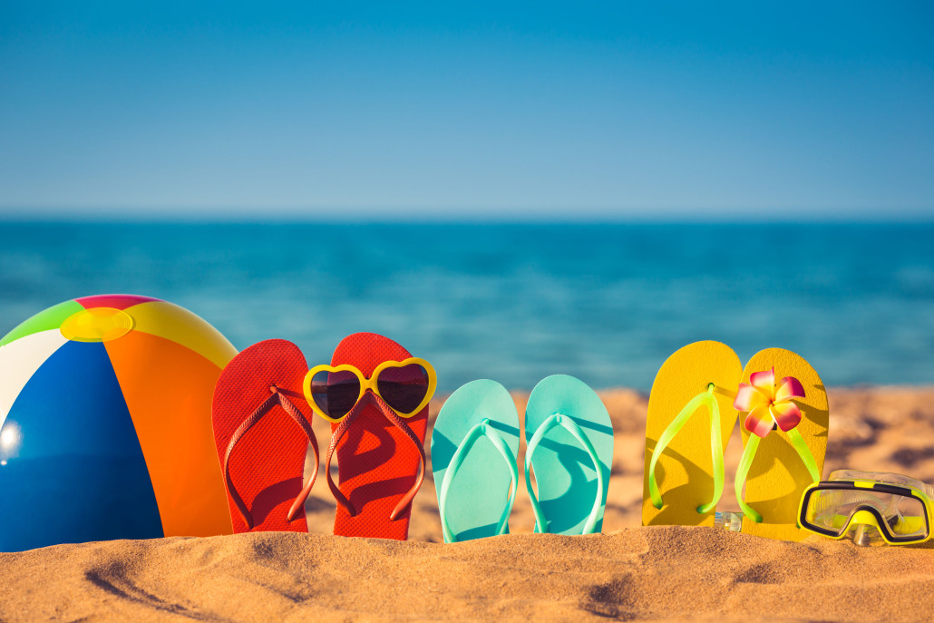
COLORS

Slide 69
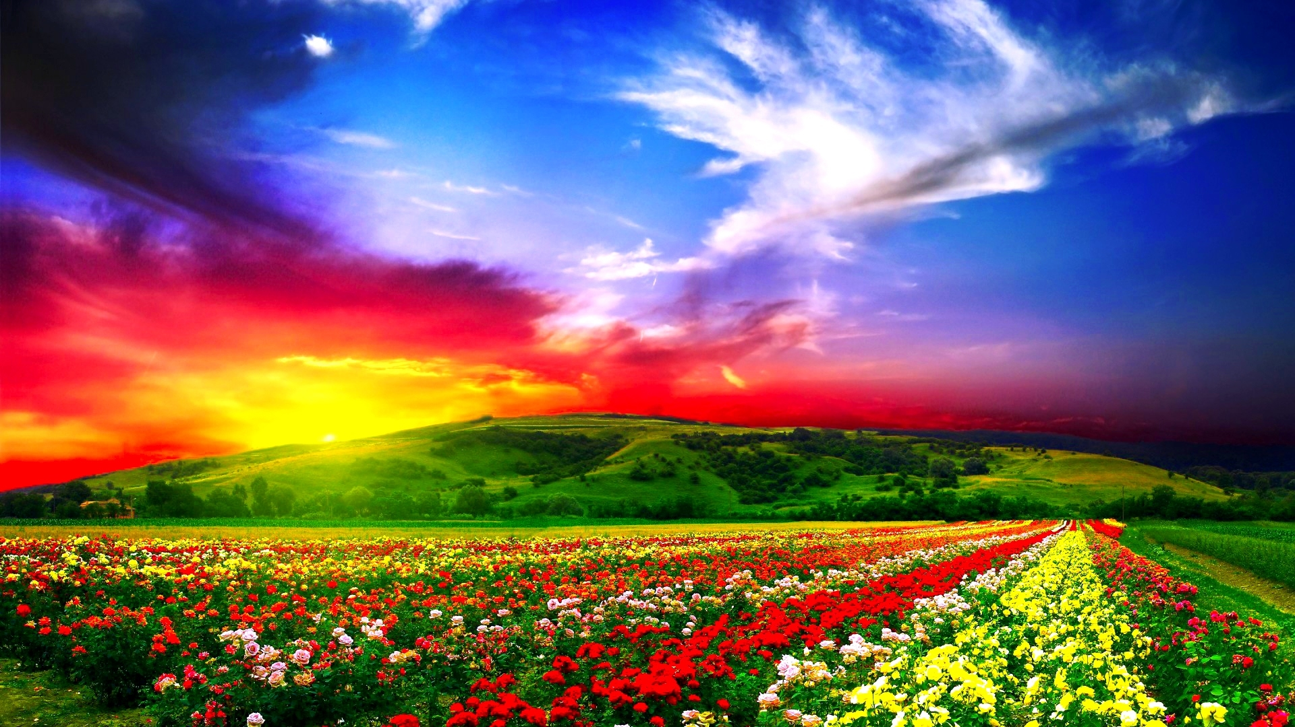
COLORS

Slide 70
COLORS

Slide 71
COLORS

Slide 72
COLORS

Slide 73
COLORS

Slide 74
COLORS
LISTEN AND MATCH NUMBER WITH COLOR.
Poslušaj in ustrezni številki pripiši ustrezno barvo.
1
2
3
4
5
6
7
8
9
10

Slide 75
WHAT IS YOUR FAVORITE COLOR?
Katera je tvoja najljubša barva?
HELLO JOHNNY!
HELLO SOPHIE!

Slide 76
WHAT IS YOUR FAVORITE COLOR?
Katera je tvoja najljubša barva?
WHAT IS YOUR FAVORITE COLOR?
MY FAVORITE COLOR IS GREEN.

Slide 77
WHAT IS YOUR FAVORITE COLOR?
Katera je tvoja najljubša barva?
MY FAVORITE COLOR IS BLUE.
WHAT IS YOUR FAVORITE COLOR?

Slide 78
WHAT IS YOUR FAVORITE COLOR?
Katera je tvoja najljubša barva?
WHAT IS YOUR FAVORITE COLOR?
MY FAVORITE COLOR IS _________.
Moja najljubša barva je ________.

Slide 79
?
ASK ME ANYTHING.
TIME FOR
QUESTIONS
Čas za vprašanja

Slide 80
NUMBERS
1
2
3
WHAT‘S YOUR NAME?
COLORS
5
4

Slide 81
4
KNOCK
potrkati
KNOCK ON THE SCREEN

Slide 82
WHAT IS HIDING IN THE BOX?
?
Kaj se skriva v škatli?

Slide 83
CLUES:
Namigi:
SMO ŠTIRJE.
VSAK PO SVOJE ZNAMO DREVESU UREDITI KROŠNJO.
VSI IMAMO POČITNICE.
NEKATERI SO ZA BUNDO DRUGI PA ZA KOPALKE.

Slide 84
SEASONS
Letni časi

Slide 85
SEASONS
Letni časi

Slide 86
SEASONS
Letni časi
SNOWFLAKE
snežinka
WINTER
zima
SPRING
pomlad
LEAF
list
SUMMER
poletje
AUTUMN
jesen
COLD
mrzlo
SEA
morje
HOT
vroče

Slide 87
SEASONS
Letni časi
DURING THE WINTER
Pozimi
SMUČATI
to ski
SLEDDING
sankanje
SNOWMAN
snežak
IGLOO
iglu
SNOWBALL FIGHT
kepanje
SNOW
sneg

Slide 88
SEASONS
Letni časi
DURING THE WINTER
Pozimi
SANTA CLAUS
Božiček
FAMILY
družina
WARM TEA
topel čaj
FIREPLACE
kamin
GIFT
darilo
ST. NICOLAS
Miklavž

Slide 89
SEASONS
Letni časi
DURING SPRING
Spomladi
FLOWER
roža
GARDENING
vrtnarjenje
ANIMALS
živali
TO SING
peti
BIRD
ptica
TO RAIN
deževati
EASTER EGGS
velikonočna jajca

Slide 90
SEASONS
Letni časi
DURING SUMMER
Poleti
SEA
morje
TO SNORKEL
potapljati se
BEACH
plaža
TO SWIM
plavati
SANDCASTLE
peščeni grad
LEMONADE
limonada
DIVING MASK
maska za potapljanje

Slide 91
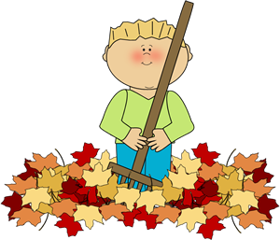
SEASONS
Letni časi
DURING AUTUMN
Jeseni
LEAF
list
SCHOOL
šola
TO FALL
padati
HALLOWEEN
Noč čarovnic
GRAPES
grozdje
PUMPKIN
buča
TO RAKE LEAVES
grabiti listje

Slide 92
WHICH SEASON IS YOUR FAVORITE?
Kateri letni čas je tvoj najljubši?
MY FAVORITE SEASON IS WINTER.
WHICH SEASON IS YOUR FAVORITE?

Slide 93
WHICH SEASON IS YOUR FAVORITE?
Kateri letni čas je tvoj najljubši?
WHICH SEASON IS YOUR FAVORITE?
MY FAVORITE SEASON IS _________.
Moj najljubši letni čas je ________.

Slide 94
MIXED UP SEASONS
Zmešani letni časi

Slide 95
?
ASK ME ANYTHING.
TIME FOR
QUESTIONS
Čas za vprašanja

Slide 96
LET‘S REVISE
PONOVIMO

Slide 97
QUESTION: IN WHICH SEASON THERE ARE THREE RABBITS?

Slide 98
QUESTION: IN WHICH SEASON THERE ARE THREE RABBITS?
ANSWER: SPRING

Slide 99
EXERCISE: MATCH THE COLOR WITH WORD.
BROWN
WHITE
ORANGE
PINK
GREEN
YELLOW
RED
BLUE
BLACK
PURPLE

Slide 100
EXERCISE: COUNT BACKWARDS
10 9 8 7 6 5 4 3 2 1

Slide 101
EXERCISE: TRY TO FIND WHICH COLOR IS HIDDEN IN MIXED LETTERS.

Slide 102
EXERCISE: SORT THINGS IN THE RIGHT SEASON.
WINTER | SPRING | SUMMER | AUTUMN

Slide 103
QUESTION: HOW MANY SNOWMANS ARE IN THE PICTURE?
VPRAŠANJE: Koliko snežakov je na sliki?

Slide 104
QUESTION: HOW MANY SNOWMANS ARE IN THE PICTURE?
VPRAŠANJE: Koliko snežakov je na sliki?
ANSWER: 5 SNOWMANS
ODGOVOR: 5 snežakov

Slide 105
QUESTION: WHICH SEASON IS IN THE PICTURE?
VPRAŠANJE: Kateri letni čas je na sliki?

Slide 106
QUESTION: WHICH SEASON IS IN THE PICTURE?
VPRAŠANJE: Kateri letni čas je na sliki?
ANSWER: WINTER
ODGOVOR: Zima

Slide 107
QUESTION: WHICH COLOURS DO YOU SEE IN THE PICTURE?
VPRAŠANJE: Katere barve vidiš na sliki?

Slide 108
QUESTION: WHICH COLOURS DO YOU SEE IN THE PICTURE?
VPRAŠANJE: Katere barve vidiš na sliki?
ANSWER:

Slide 109
QUESTION: WHAT DOESN‘T BELONG IN THE PICTURE?
VPRAŠANJE: Kaj ne sodi na sliko?

Slide 110
QUESTION: WHAT DOESN‘T BELONG IN THE PICTURE?
VPRAŠANJE: Kaj ne sodi na sliko?
ANSWER: PUMPKIN
ODGOVOR: Buča

Slide 111
QUESTION: IN WHICH SEASON DOES THE PUMPKIN BELONG?
VPRAŠANJE: V kateri letni čas sodi buča?

Slide 112
QUESTION: WHAT DOESN‘T BELONG IN THE PICTURE?
VPRAŠANJE: Kaj ne sodi na sliko?
ANSWER: PUMPKIN
ODGOVOR: Buča

Slide 113
QUESTION: IN WHICH SEASON DOES THE PUMPKIN BELONG?
VPRAŠANJE: V kateri letni čas sodi buča?

Slide 114
QUESTION: IN WHICH SEASON DOES THE PUMPKIN BELONG?
VPRAŠANJE: V kateri letni čas sodi buča?
ANSWER: IN AUTUMN
ODGOVOR: V jesen

Slide 115
GOOD JOB!

Slide 116
NUMBERS
1
2
3
WHAT‘S YOUR NAME?
COLORS
5
4
SEASONS

Slide 117
1
2
3
5
4
6
8
7

Slide 118
WELL DONE!

